Slide 1
FUZZING GO AND PYTHON PROJECTS IN OSS-FUZZ: THE OPENPRINTING CASE STUDY
Mohammed Imaduddin

Slide 2


TALK ROADMAP
INTRODUCTION
OSS-FUZZ
FUZZING BASICS
CHALLENGES & SOLUTIONS
OPENPRINTING ECOSYSTEM
ACKNOWLEDGEMENTS
FUZZING HARNESSES

Slide 3

THE PROBLEM
  Software bugs can turn into serious security risks
  Small flaws in infrastructure code → large-scale impact
  Example: Heartbleed in OpenSSL (data leaks from millions of servers)

Slide 4




Heartbleed
Encrypted Message
xKyFjQF4qKkB9LV53Xz1lXiR9JEAh
Hi, David
Hi, David
YOU
SERVER
RECIEVER
DATA LEAKAGE
xKyFjQF4qKkB9LV53Xz1lXiR9JEAh
HACKER
Hi, David

Slide 5
Heartbleed
ARE YOU THERE? THE MAGIC WORD IS
"GIRAFFE," WHICH IS 100 CHARACTERS LONG.
HACKER
YES I'M HERE.
YOUR MAGIC WORD WAS
"GIRAFFE 1^V6%$JOHN SMITH:645-43-5324:07/19/1982:JSMITH:
SECR3TPASSW0RD:202-563-1234 SMITH@EMAIL.COM$."
DATA LEAKAGE

Slide 6
TESTING GAP
  Unit tests check expected behavior only
  Fail to cover malformed or adversarial inputs
  Gaps appear in complex protocols (network, USB, file formats)

Slide 7
WHY FUZZING ?
  Dynamic testing with automated input generation
  Exercises unusual code paths at scale
  Detects crashes, memory corruptions, leaks, and hangs
  Generates minimal reproducible test cases for triage
  Continuously improves coverage with feedback-guided fuzzing

Slide 8
WHAT IS FUZZING?
A dynamic software testing mechanism that runs (in an instrumented and optimised fashion) the software under test (through its harness) with tailored (eventually random) (formatted or unformatted) (eventually based on an initial corpus) inputs to detect unexpected behaviours such as crashes, assertions, memory leaks, race conditions and undefined behaviours

Slide 9


WHAT IS FUZZING?
program
Fuzzed Input:
  DDLDRD
  DDLDDD
  DDLDRRRD
  DDLDRRD
  DLRLRLRL

Slide 10
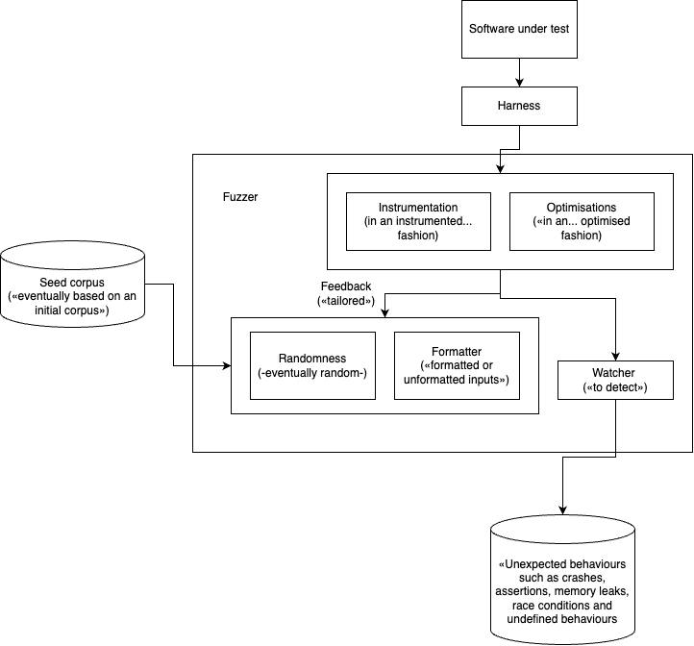
WHAT IS FUZZING?

Slide 11
WHAT IS FUZZING?
Fuzzing is a way of testing software by automatically feeding it lots of generated inputs (random or from examples) to see if it crashes or behaves unexpectedly.

Slide 12
WHY FUZZING ?
  Dynamic testing with automated input generation
  Exercises unusual code paths at scale
  Detects crashes, memory corruptions, leaks, and hangs
  Generates minimal reproducible test cases for triage
  Continuously improves coverage with feedback-guided fuzzing

Slide 13

OpenPrinting Ecosystem
  Part of the Linux Foundation
  maintains printing stack for Unix based OS
  Ensures interoperability with printers (network, USB, cloud)
  Provides critical libraries, drivers, and tools used in distros

Slide 14
OpenPrinting Ecosystem
Key components in this project:
  goipp – Go library for IPP (Internet Printing Protocol)
  ipp-usb – IPP-over-USB daemon bridging USB printers to network services
  pycups – Python bindings for libcups (manage print jobs, queues)
  pyppd – Python utilities for parsing/managing PPD files

Slide 15
Fuzzing Harness
goipp
  DecodeBytes / DecodeBytesEx: Entry points for parsing raw IPP requests, attacker-controlled input
  Round-trip (Encode + Decode): Validates serialization integrity, prevents silent data corruption
  Collections / TagExtension: Complex, optional IPP features, rarely exercised in normal tests

Slide 16
Fuzzing Harness
ipp-usb
  daemon_fuzzer: The main entry point handling client requests → directly exposed to attackers.
  usb_fuzzer: USB packet parsing is error-prone and legacy-heavy → easy fuzzing wins.
  http_client_fuzzer: Handles responses from printers/servers, which may be malicious or malformed.

Slide 17
Fuzzing Harness
pycups
  Auth & buffer handling: Directly process sensitive or size-limited inputs → classic bug class.
  File I/O: Exposed to user-supplied filenames/streams → risk of edge cases.
  Printer/job management: Involves complex combinations of parameters.
  UTF-8 conversions: Encoding bugs can cause subtle corruption or crashes.

Slide 18
Fuzzing Harness
pyppd
  parse() and compression: Input parsing & decompression are classic fuzzing goldmines.
  File lookup functions: Arbitrary filenames can trigger path traversal or unexpected errors.
  CLI handling: Command-line parsing is a frequent source of crashes or unexpected behavior.

Slide 19

OSS-FUZZ FROM GOOGLE
  Continuous fuzzing infrastructure for critical open source projects
  Free
  OSS-Fuzz has helped identify and fix over 10,000 vulnerabilities and 36,000 bugs across 1,000 projects
  Supports:
    Multiple fuzzers: libFuzzer, AFL++, Honggfuzz, and Centipede
    Multiple languages: C, C++, Go, Java, Javascript, Python, Rust, and Swift
    CPU architectures: x86_64, i386

Slide 20
Challenge: Fuzzing ipp-usb without Hardware
  ipp-usb is a standalone daemon, not a library → hard to fuzz internally
  Direct fuzzing failed due to libusb dependencies and linker errors
  Needed a virtual IPP-over-USB device to replace real hardware

Slide 21
My Solution
  Created a virtual IPP-over-USB device using the USBIP protocol
  Emulated correct USB class/subclass/protocol (07/01/04)
  Supported required interfaces + bulk IN/OUT endpoints
  Allowed ipp-usb to connect and exchange requests

Slide 22
Why It Mattered ?
  Allowed fuzzing of ipp-usb in a black-box setup
  No dependency on physical printers
  Exposed realistic request/response flow for fuzzing
  Cleared path to OSS-Fuzz integration

Slide 23
Acknowledgement
  Mentors
    Till Kamppeter – Head, OpenPrinting
    George-Andrei Iosif – Senior Security Engineer, Snap Inc.
    Jiongchi Yu – ph.D student at SMU
  Communities & Programs
    OpenPrinting & The Linux Foundation
    Google Summer of Code
    OSS-Fuzz maintainers

Slide 24




Thank You
Any questions?
@mdimado

