Slide 1
INTRO TO OSS-FUZZ
BUILD, BREAK, AND HARDEN OPEN SOURCE SOFTWARE
Mohammed Imaduddin

Slide 2
WORKSHOP AGENDA
INTRODUCTION
FUZZING BASICS
TARGETING markdown2
OSS-FUZZ WORKFLOW DEMO

Slide 3


WHAT IS FUZZING?
A dynamic software testing mechanism that runs (in an instrumented and optimised fashion) the software under test (through its harness) with tailored (eventually random) (formatted or unformatted) (eventually based on an initial corpus) inputs to detect unexpected behaviours such as crashes, assertions, memory leaks, race conditions and undefined behaviours

Slide 4


WHAT IS FUZZING?
program
Fuzzed Input:
DDLDRD
DDLDDD
DDLDRRRD
DDLDRRD
DLRLRLRL

Slide 5
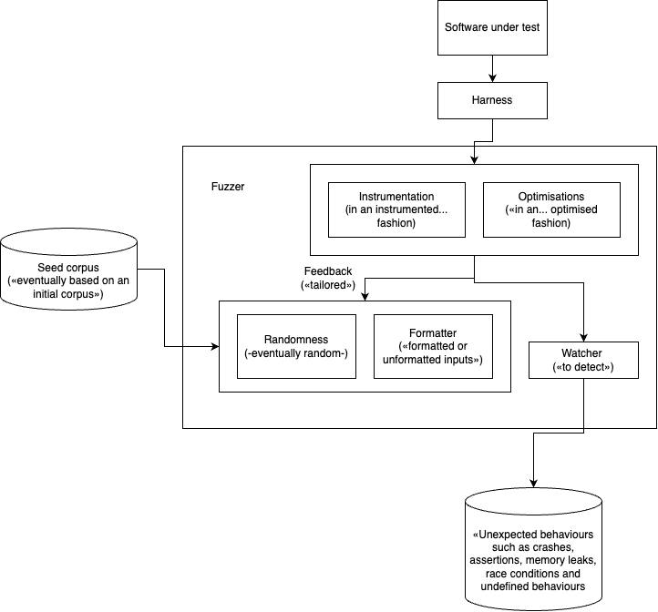
WHAT IS FUZZING?

Slide 6
WHAT IS FUZZING?
Fuzzing is a way of testing software by automatically feeding it lots of generated inputs (random or from examples) to see if it crashes or behaves unexpectedly.

Slide 7
Random vs Coverage-guided
Random fuzzing
Feeds purely random inputs
Finds only shallow bugs
Inefficient, many invalid inputs
Coverage-guided fuzzing
Tracks which code paths are exercised
Mutates inputs to reach unexplored branches
More efficient, finds deeper bugs

Slide 8

OSS-FUZZ FROM GOOGLE
Continuous fuzzing infrastructure for critical open source projects
Free
OSS-Fuzz has helped identify and fix over 10,000 vulnerabilities and 36,000 bugs across 1,000 projects
Supports:
Multiple fuzzers: libFuzzer, AFL++, Honggfuzz, and Centipede
Multiple languages: C, C++, Go, Java, Javascript, Python, Rust, and Swift
CPU architectures: x86_64, i386

Slide 9
ATHERIS: PYTHON FUZZING ENGINE
Coverage-guided fuzzer built for Python
Instruments Python bytecode at runtime
Works with pure Python code and C extension modules
Detects crashes, exceptions, and sanitizer issues
Integrates seamlessly with OSS-Fuzz infrastructure

Slide 10
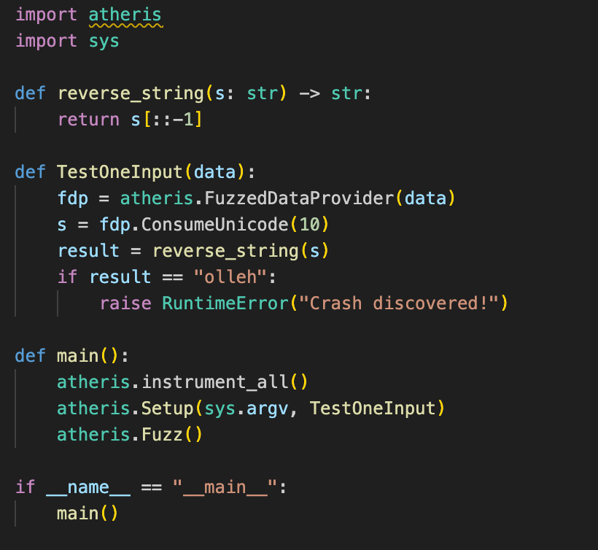

ATHERIS: PYTHON FUZZING ENGINE
Target function
fuzzing entrypoint
turns raw bytes into useful types
call the target function
with crash condition
instrument modules
setup the fuzzer and start fuzzing

Slide 11
fuzzing python-markdown2

Slide 12

popular Markdown parser
Processes user-controlled input (Markdown → HTML)
fuzzing python-markdown2
Parsing libraries are common sources of crashes or security issues
Even mature libraries can fail on unexpected input

Slide 13
target LinkProcessor

Slide 14
Handles links inside Markdown
Frequently executed in real usage, so bugs have high impact
target LinkProcessor
Deals with brackets, regex, and nested structures, which are error-prone
Malformed input can trigger crashes or security issues

Slide 15
Before we move ahead

Slide 16
Do you have the setup?
If not, install Python 3 + Docker, and run:
$ git clone https://github.com/google/oss-fuzz
$ git clone https://github.com/mdimado/oosc

Slide 17
Initializing the project

Slide 18
host $ cd oss-fuzz
host $ export PROJECT_NAME=python-markdown2
host $ export LANGUAGE=python
host $ python infra/helper.py generate \
$PROJECT_NAME \
--language=$LANGUAGE
host $ cd projects/$PROJECT_NAME
host $ ls

Slide 19
Registers your project with OSS-Fuzz
Filling up project.yaml
Provides metadata: project name, language, fuzzer executable, sanitizer settings

Slide 20
host $ cd ..
host $ mv oosc/project.yaml \
oss-fuzz/projects/python-markdown2/

Slide 21
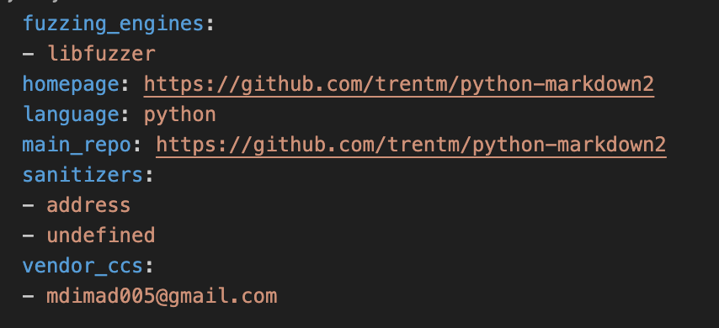
project.yaml
The fuzzing tool(s) to use, here libFuzzer.
Runtime checks to detect memory and undefined behavior errors.
Contact email(s) of the project maintainer(s) or responsible person

Slide 22
Creates a controlled environment for building and running the fuzzer
Filling up Dockerfile
Ensures all dependencies (Python, libraries, tools) are present

Slide 23
host $ cd ..
host $ mv oosc/Dockerfile \
oss-fuzz/projects/python-markdown2/

Slide 24
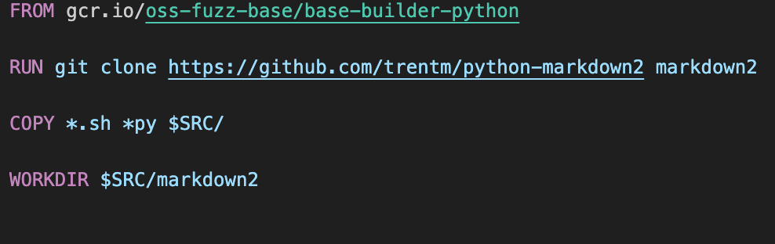
Dockerfile
OSS-Fuzz’s Python base Docker image
Copy all shell scripts and Python files
Set the working directory inside the container to the cloned markdown2 folder

Slide 25
Script to compile and prepare your project for fuzzing
Filling up build.sh
Can include installation of dependencies, compilation of C extensions, etc.

Slide 26
host $ cd ..
host $ mv oosc/build.sh \
oss-fuzz/projects/python-markdown2/

Slide 27
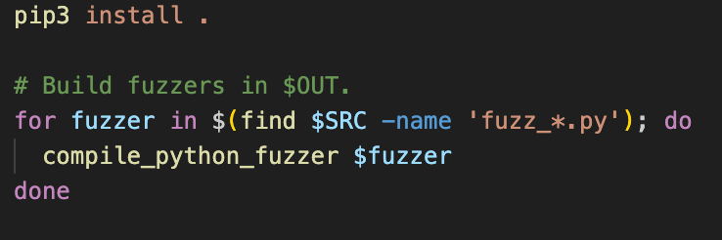
build.sh
Compile each fuzzing script into a binary that OSS-Fuzz can run.

Slide 28
Writing the fuzz harness

Slide 29
host $ cd ..
host $ mv oosc/fuzz_linkProcessor.py \
oss-fuzz/projects/python-markdown2/

Slide 30
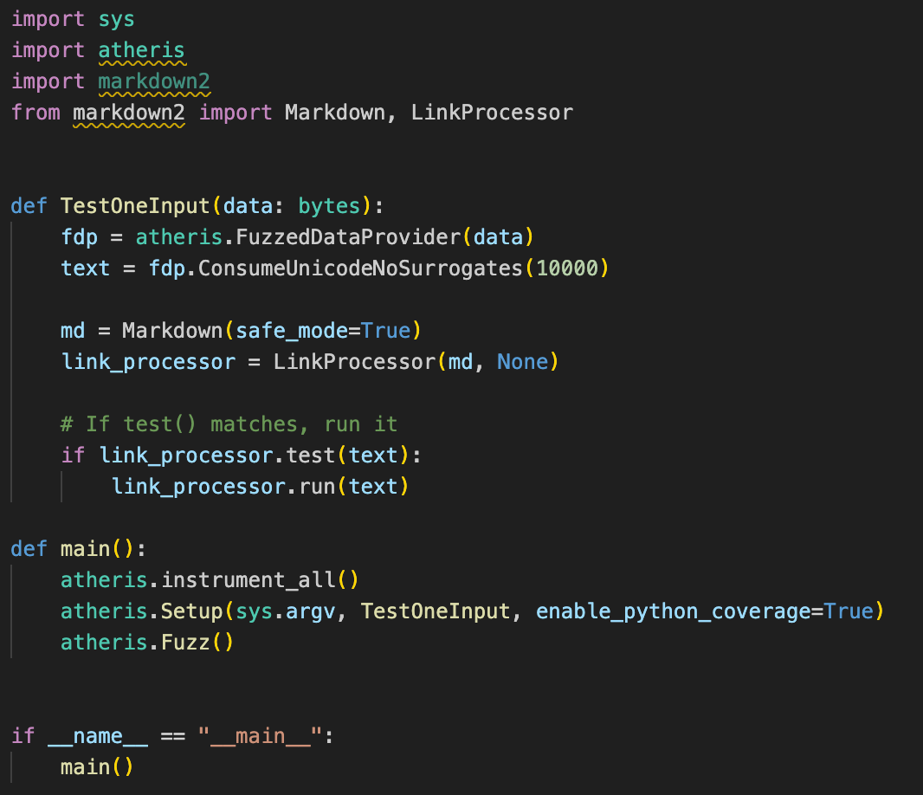
fuzz_linkProcessor.py
Target function
fuzzing entrypoint
turns raw bytes into useful types
create Markdown and LinkProcessor instances
Runs the link processor on the fuzzed input
instrument all modules
setup the fuzzer and start fuzzing

Slide 31
Building the fuzzers

Slide 32
host $ cd oss-fuzz
host $ python infra/helper.py \
build_fuzzers \
$PROJECT_NAME

Slide 33
Running the fuzzer

Slide 34
host $ cd oss-fuzz
host $ python infra/helper.py \
run_fuzzer \
$PROJECT_NAME \
fuzz_linkProcessor

Slide 35
The Crash

Slide 36
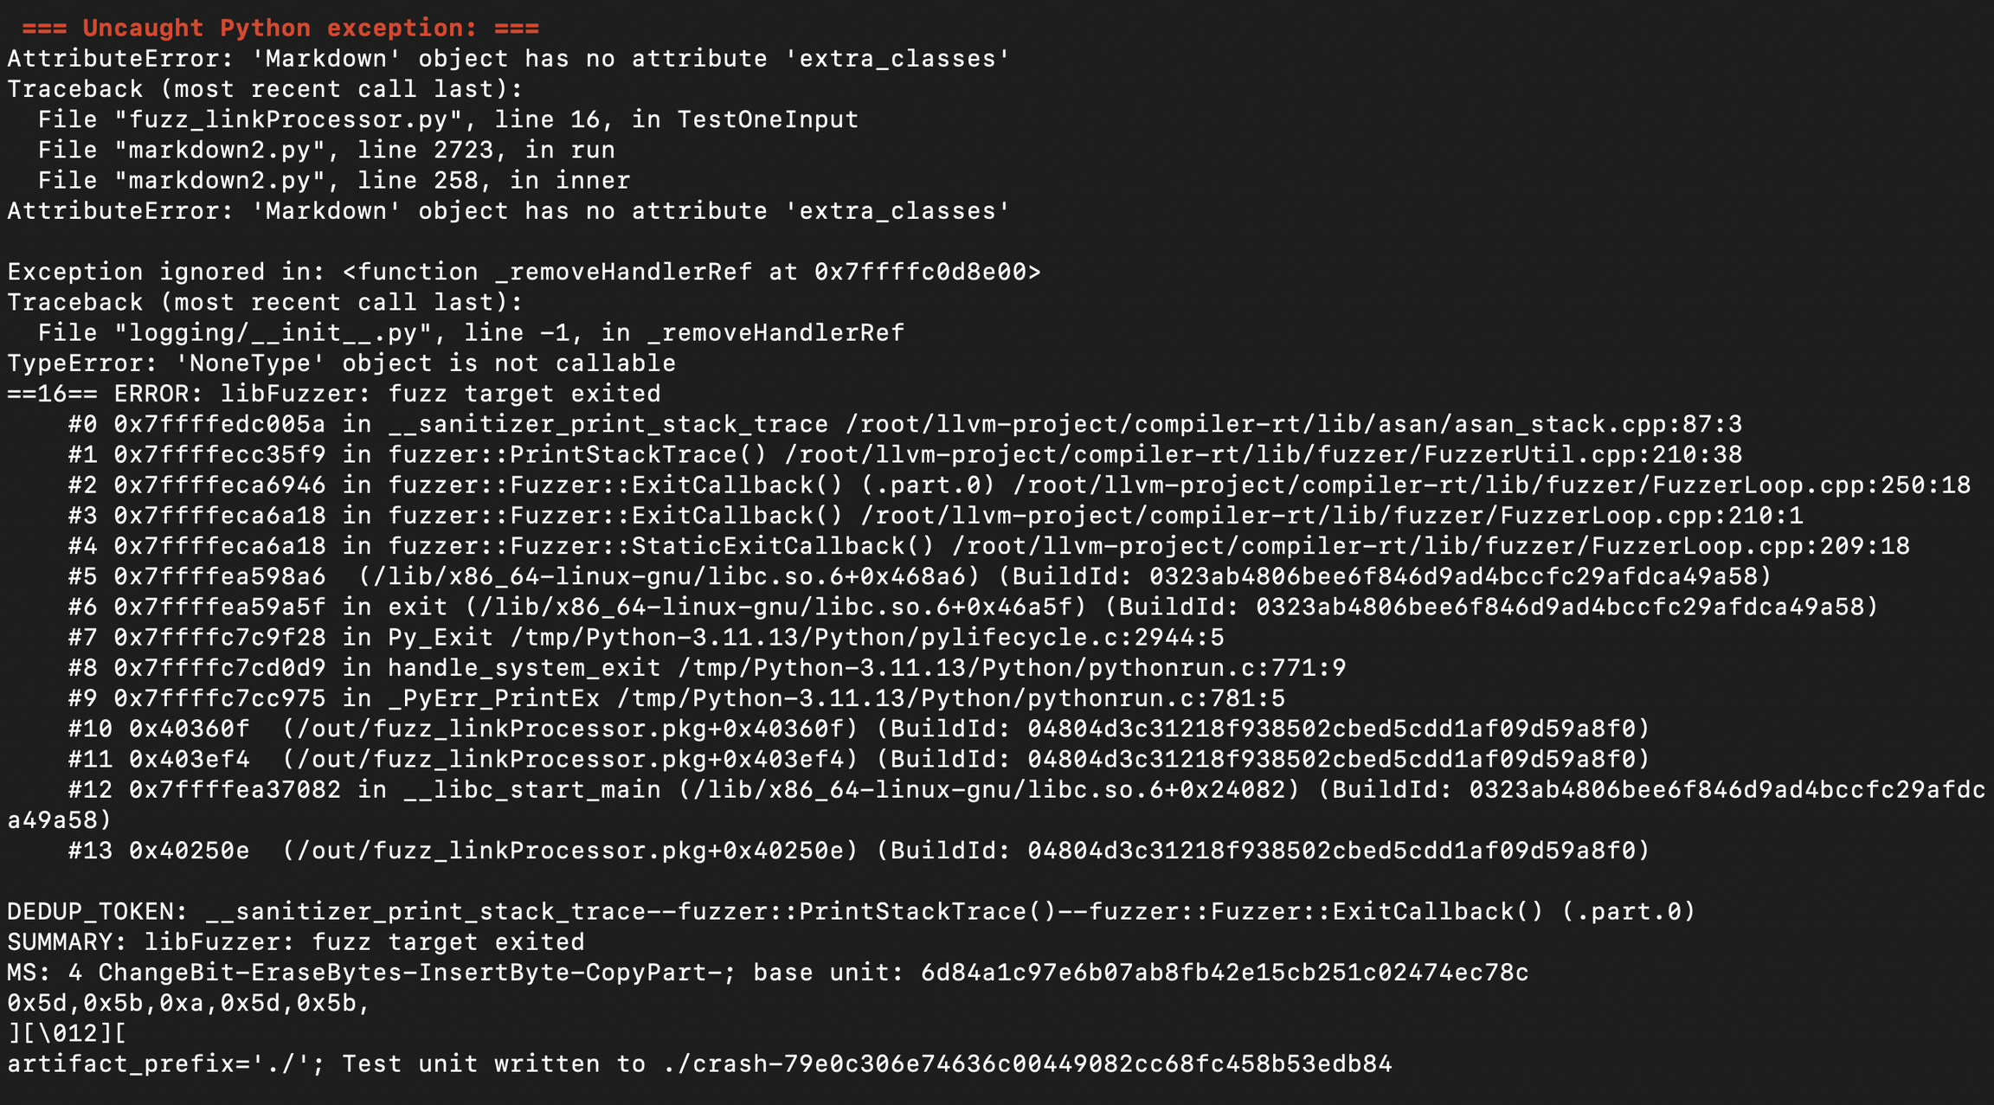

Slide 37
What caused the Crash?
host $ cd build/out/python-markdown2
host $ ls
host $ less ./crash-

Slide 38
Why it matters?
Even well-tested libraries can have hidden assumptions.
Fuzzing uncovers these edge cases automatically.
This crash is minor (AttributeError), but it shows the kind of unexpected behavior fuzzers can reveal.

Slide 39
Having a PR accepted inside the OSS-Fuzz repo
Describe Project purpose and importance.
List major users.
Highlight critical role of the project.
Link maintainer's approval and fuzz target PR.
Tip: Addressing these points helps our panel decide on accepting your integration.

Slide 40
Resources & Next Steps
Atheris GitHub: https://github.com/google/atheris – Python fuzzing library
OSS-Fuzz Documentation: https://google.github.io/oss-fuzz/ – Guide to continuous fuzzing
Demo Repository: https://github.com/mdimado/oosc – Contains example harness, Dockerfile, and build scripts
Start fuzzing your own Python projects using Atheris
Explore fuzzing Python projects with C extensions
Investigate crashes, reproduce them, and submit fixes or patches

Slide 41




Thank You
Any questions?
@mdimado

