Slide 1


The Future of Virtualization: Trends, Technologies, and Market Insights
Exploring Key Developments and Strategic Directions in Virtualization for 2025 and Beyond
Saquib Akhtar, Linux IDM T3 Specialist & Lead
Nokia

Slide 2
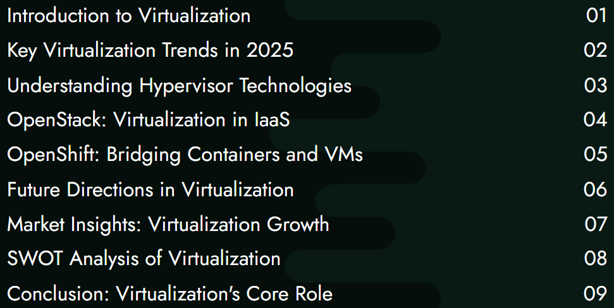
Table of Contents

Slide 3
Introduction to Virtualization
Abstract Virtualization continues to be the bedrock of modern IT infrastructure, enabling flexible, efficient, and scalable environments. This paper outlines key trends in virtualization, explains the role of hypervisors, and provides a concise understanding of how platforms like OpenStack and OpenShift build upon these technologies. It aims to present a 360-degree view of how virtualization continues to evolve and support emerging computing paradigms.
Virtualization, once primarily used for server consolidation, has evolved into a core component of cloud-native architecture. As enterprises move toward hybrid cloud and edge deployments, virtualization technologies underpin not only traditional VMs but also containers, microservices, and orchestration platforms like Kubernetes. This paper highlights the trends, types of hypervisors, and the role of virtualization in managing platforms like OpenStack and OpenShift.

Slide 4
Key Virtualization Trends in 2025
Hybrid and Multi-Cloud Infrastructures: Organizations use virtualization to run workloads seamlessly across private and public clouds.
Container-native Virtualization: Containers rely on virtualization at the OS level. Technologies like Kata Containers bridge the gap between containers and VMs.
Edge Virtualization: With latency-sensitive applications growing, KVM and lightweight hypervisors are being used on edge devices.
Security Enhancements: Modern hypervisors incorporate features like encrypted memory, VM introspection, and secure boot.

Slide 5
Understanding Hypervisor Technologies
Hypervisors are categorized into two types:
Type 1 (Bare-metal):
  VMware ESXi: Industry standard in enterprise environments.
  KVM: Embedded in the Linux kernel, default choice for open-source platforms.
  Xen: Used in cloud services such as Amazon EC2.
Type 2 (Hosted):
  Oracle VirtualBox: Widely used in development environments.
  VMware Workstation/Fusion: Professional desktop hypervisors.
These technologies isolate workloads and enable the running of multiple operating systems on the same hardware platform.

Slide 6
OpenStack: Virtualization in IaaS
OpenStack is an Infrastructure-as-a-Service (IaaS) platform built entirely on virtualization:
Nova (Compute) relies on hypervisors like KVM, Xen, or VMware.
Neutron (Networking) provides virtualized network components.
Cinder (Block Storage) and Glance (Images) manage virtual disk volumes and images.
OpenStack enables automation and orchestration of virtual machines, making it a go-to choice for private cloud and NFV environments.

Slide 7
OpenShift: Bridging Containers & VMs
OpenShift, Red Hat's Kubernetes-based PaaS, emphasizes containerization but still uses virtualization concepts:
CRI-O and Podman manage container runtimes.
KubeVirt allows VMs to run alongside containers in Kubernetes clusters, using KVM under the hood.
This blending of virtual machines and containers ensures compatibility for legacy applications while moving toward microservices.

Slide 8
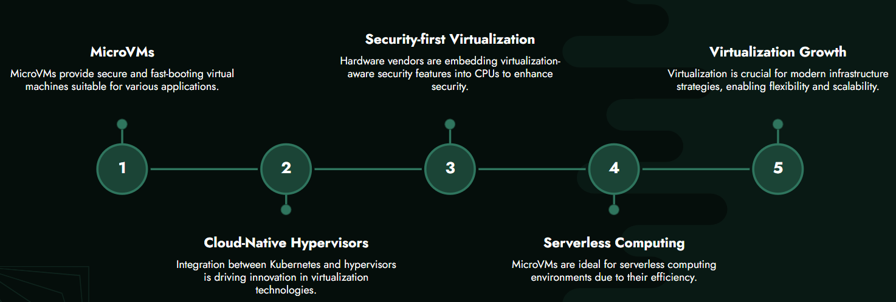
Future Directions in Virtualization

Slide 9
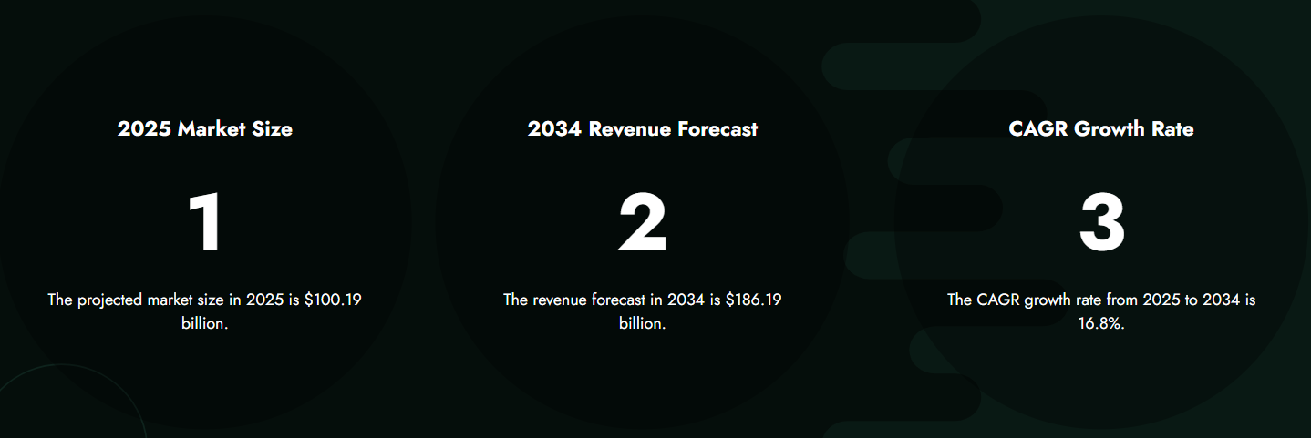
Market Insights: Virtualization Growth

Slide 10
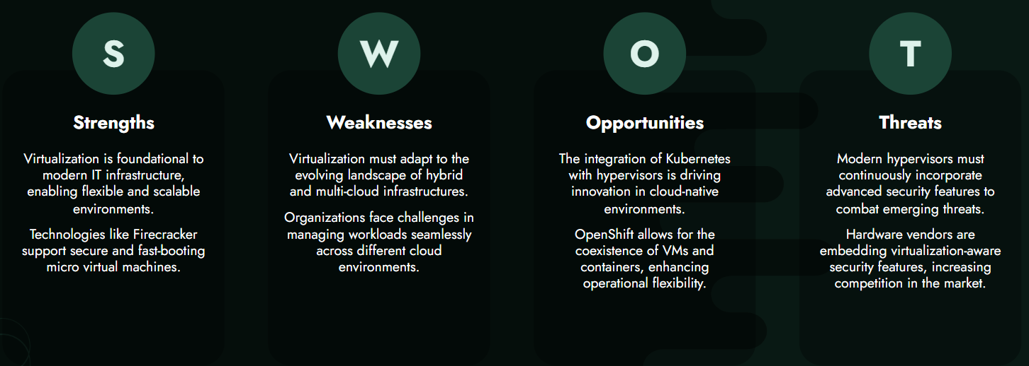
SWOT Analysis of Virtualization

Slide 11
Conclusion: Virtualization's Core Role
Virtualization remains foundational to infrastructure strategies. From powering traditional data centers to enabling flexible hybrid and edge environments, it adapts and integrates with container-based and cloud-native paradigms. Hypervisors and virtualization platforms like OpenStack and OpenShift illustrate how the underlying technologies evolve while maintaining their core importance in enterprise computing.

Slide 12
Report Attribute | Details
Market Size Value In 2025 | $100.19 billion
Revenue Forecast In 2034 | $186.19 billion
Growth Rate | CAGR of 16.8% from 2025 to 2034
Base Year For Estimation | 2024
Actual Estimates/Historical Data | 2019-2024
Forecast Period | 2025 - 2029 - 2034
Market Representation | Revenue in USD Billion and CAGR from 2025 to 2034
Segments Covered | 1) By Type: Storage Virtualization, Application Virtualization, Network Virtualization, Hardware Virtualization, Server Virtualization, Operating System (OS) Virtualization, Other Types 2) By Platform: PC Virtualization, Mobile Virtualization 3) By Deployment: On-Premises Virtualization, Cloud-Based Virtualization 4) By Organization Size: Small And Medium-Sized Enterprises (SMEs), Large Enterprises Subsegments: 1) By Storage Virtualization: Block-Level Storage Virtualization, File-Level Storage Virtualization, Object Storage Virtualization 2) By Application Virtualization: Desktop Virtualization, Virtualized Application Streaming, Application Delivery 3) By Network Virtualization: Software-Defined Networking (SDN), Network Function Virtualization (NFV), Virtual Network Infrastructure 4) By Hardware Virtualization: Full Virtualization, Paravirtualization, Hardware-Assisted Virtualization 5) By Server Virtualization: Virtual Machine (VM) Server Virtualization, Containerization (Docker, Kubernetes), Hypervisor-based Virtualization 6) By Operating System (OS) Virtualization: OS-Level Virtualization (Containers), Virtual Private Servers (VPS), Lightweight Virtualization 7) By Other Types: Storage Area Network (SAN) Virtualization, Data Virtualization, Cloud Virtualization

