Slide 1


OOSC 4.0 | IIIT Allahabad | Aug 28-30, 2026
One Micro-Commit at a Time
Migrating Legacy GNOME Apps to GTK4
Divyanshu Rajput | GNOME Foundation Contributor
linkedin.com/in/divyanshu-rajput8171 | x.com/DivyanshuRaj81 | gitlab.gnome.org/divyanshurajput0987
Track: Development / Coding

Slide 2
A Bit About Me
Divyanshu Rajput
B.Tech in Computer Science | MJP Rohilkhand University, India
GNOME Foundation
LiFT'26 Scholar
Meta Hacker Cup 2025
TCS CodeVita 2025
Active Contributor since 7 months
Driving the GTK3 to GTK4 migration for Gitg
Shubhra Kar LiFT Scholarship
by The Linux Foundation
Qualified
Global Rank: 3957
Qualified
Global Rank: 4710
Divyanshu Rajput | GNOME Foundation Contributor | OOSC 4.0, IIIT Allahabad

Slide 3
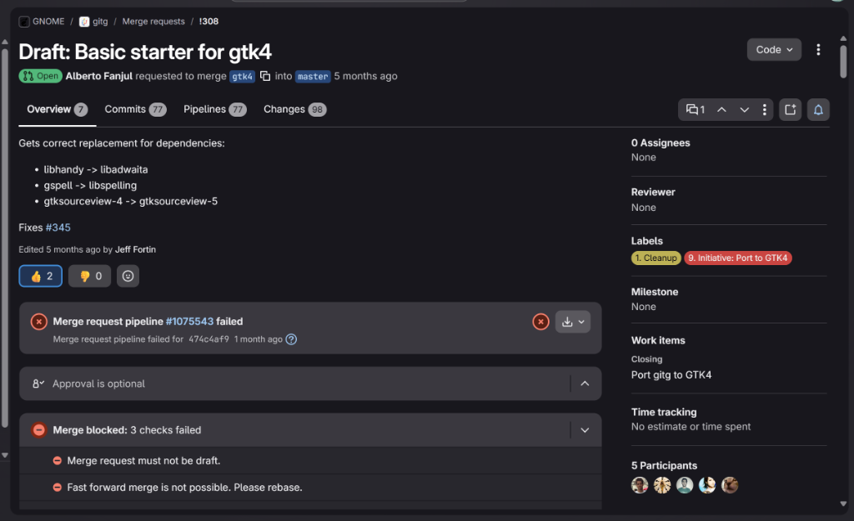
What is Gitg?
GNOME's official Git repository browser
Written in Vala and C
Ships with major Linux distributions
Currently undergoing a massive GTK3 to GTK4 migration
Maintainer: Alberto Fanjul (@albfan)
Divyanshu Rajput | GNOME Foundation Contributor | OOSC 4.0, IIIT Allahabad

Slide 4
The Challenge
Thousands of lines of deprecated GTK3 API calls
Removed widget types and missing GTK4 equivalents
Complex legacy event handling (button_press_event, etc.)
Build system dependencies need updating (libhandy -> libadwaita)
98 changed files in the base migration MR alone (!308)
Divyanshu Rajput | GNOME Foundation Contributor | OOSC 4.0, IIIT Allahabad

Slide 5
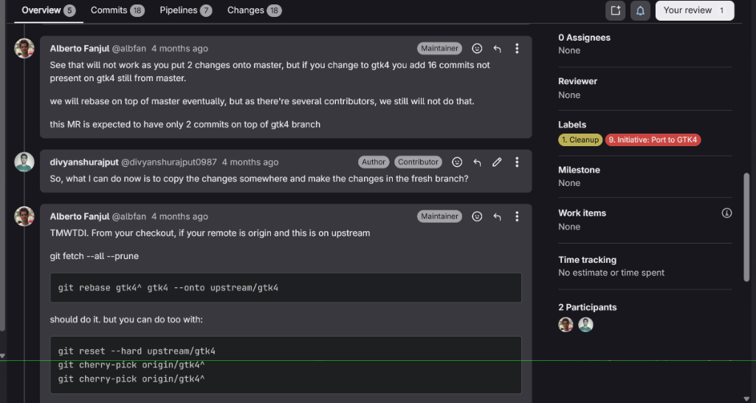
The First Hurdle: Making Mistakes
Before I could write GTK4 code, I had to learn Git rebasing the hard way...
Key Lesson:
Maintainers are mentors,
not gatekeepers.
It's okay to make mistakes.
Divyanshu Rajput | GNOME Foundation Contributor | OOSC 4.0, IIIT Allahabad

Slide 6
How NOT to Migrate
The Heroic Rewrite
The Micro-Commit Way
Rewrite everything in one massive MR
Impossible for maintainers to review
Breaks stable, working code
Leads to burnout and abandoned PRs
Tiny, focused MRs (2-15 lines each)
Address exactly ONE deprecated API
Easy to review, easy to merge
Maintain constant forward momentum
Divyanshu Rajput | GNOME Foundation Contributor | OOSC 4.0, IIIT Allahabad

Slide 7
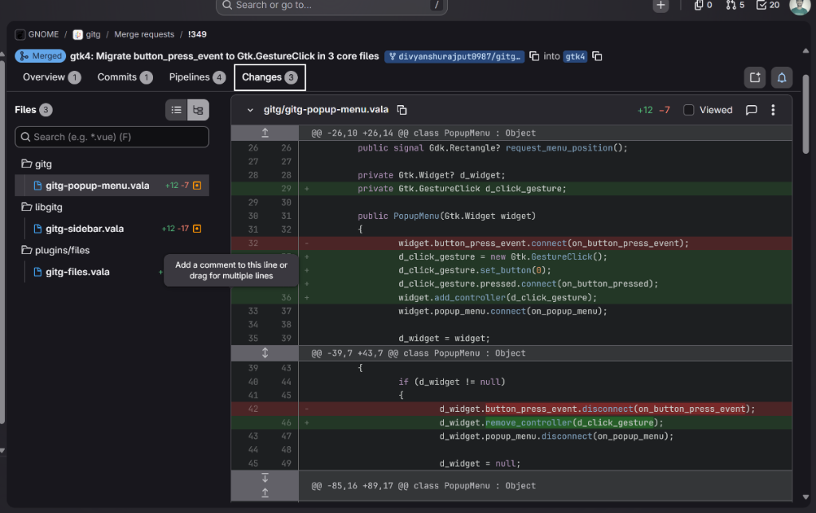
Example 1: Modernizing Event Handling
MR !349: Migrate button_press_event to Gtk.GestureClick in 3 core files | Merged
What Changed:
GTK3:
button_press_event signal
GTK4:
Gtk.GestureClick controller
Why:
GTK4 uses event controllers
instead of signal-based
event handling
Divyanshu Rajput | GNOME Foundation Contributor | OOSC 4.0, IIIT Allahabad

Slide 8
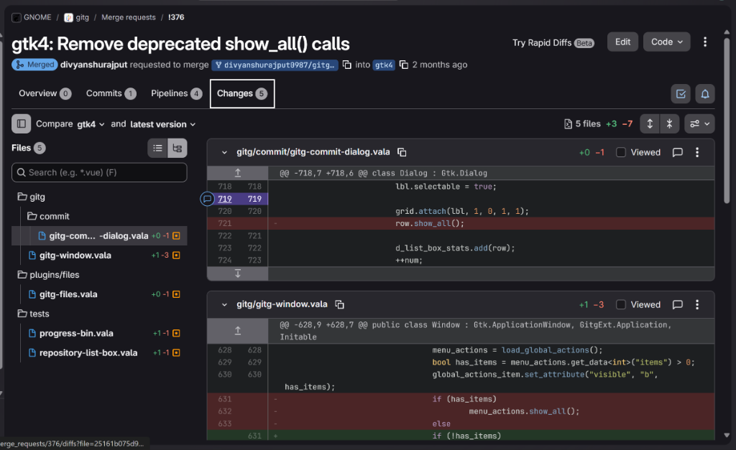
Example 2: Removing Deprecated Calls
MR !376: Remove deprecated show_all() calls | 5 files | Merged
What Changed:
GTK3:
Widgets are hidden by default.
show_all() makes them visible.
GTK4:
Widgets are visible by default.
show_all() no longer exists.
Divyanshu Rajput | GNOME Foundation Contributor | OOSC 4.0, IIIT Allahabad

Slide 9
Standing on the Shoulders of Maintainers
Alberto Fanjul (maintainer) created MR !308: The base GTK4 starter
77 commits, 98 changed files, massive dependency updates
Our micro-commits are built ON TOP of this foundation
We handle the remaining deprecated APIs one at a time
This is how open-source collaboration truly works
Divyanshu Rajput | GNOME Foundation Contributor | OOSC 4.0, IIIT Allahabad

Slide 10
Building Trust Upstream
Communicate early and often with maintainers
Accept code review feedback gracefully
Keep a clean commit history (rebase, squash)
Be patient - reviews take time
Consistency builds trust as an outside contributor
Divyanshu Rajput | GNOME Foundation Contributor | OOSC 4.0, IIIT Allahabad

Slide 11
Key Takeaways
01
02
03
04
Start Small
Stay Consistent
Learn in Public
Anyone Can Contribute
10-line MRs are better
than 1000-line rewrites
One commit a week beats
one sprint a month
Mistakes are part of the
journey - embrace them
You don't need to be an
expert to start
Divyanshu Rajput | GNOME Foundation Contributor | OOSC 4.0, IIIT Allahabad

Slide 12
Thank You!
Let's Connect & Start Contributing
GitLab: gitlab.gnome.org/divyanshurajput0987
LinkedIn: linkedin.com/in/divyanshu-rajput8171
Twitter/X: x.com/DivyanshuRaj81
Opportunity Open Source Conference 4.0 | IIIT Allahabad | August 28-30, 2026

