Slide 1

“Zabbix: Open-Source Monitoring at Scale”
Scalable Open-Source Monitoring for IT, Cloud & Beyond
Empowering Enterprises with Reliability, Flexibility, and Community
Saquib Akhtar, Solution Designer
Nokia

Slide 2

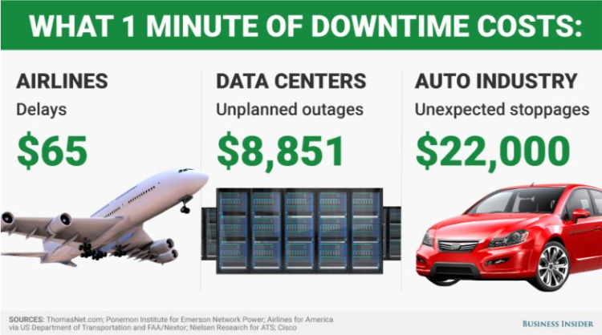
Why to monitor?
Prevent downtime.
Make big IT environments transparent & easy to manage.
Collect and visualize real-time data, analyze and make trend-
predictions.
Enable better planning & purchasing.

Slide 3
Zabbix journey
24 years of experience ZABBIX is an enterprise-level monitoring system designed to monitor millions of metrics in real time, collected from tens of thousands of servers, virtual machines, network devices and applications.
Zabbix Journey (2001 – 2025)
2001 – First release of Zabbix by Alexei Vladishev
2004 – Zabbix SIA founded (commercial support + development)
2012 – Zabbix 2.0 introduced distributed monitoring & better scalability
2015 – Zabbix 3.0 launched with encryption & visualization upgrades
2017 – Zabbix 4.0 (LTS) released – high performance, dashboards improved
2020 – Zabbix 5.0 (LTS) with modern UI, new integrations, security focus
2022 – Zabbix 6.0 (LTS) – HA support, business services, advanced integrations
2024 – Zabbix 7.0 (LTS) – scalability boosts, new plugins, cloud-native improvements
2025 – Zabbix celebrated 24 years in the open-source monitoring space

Slide 4
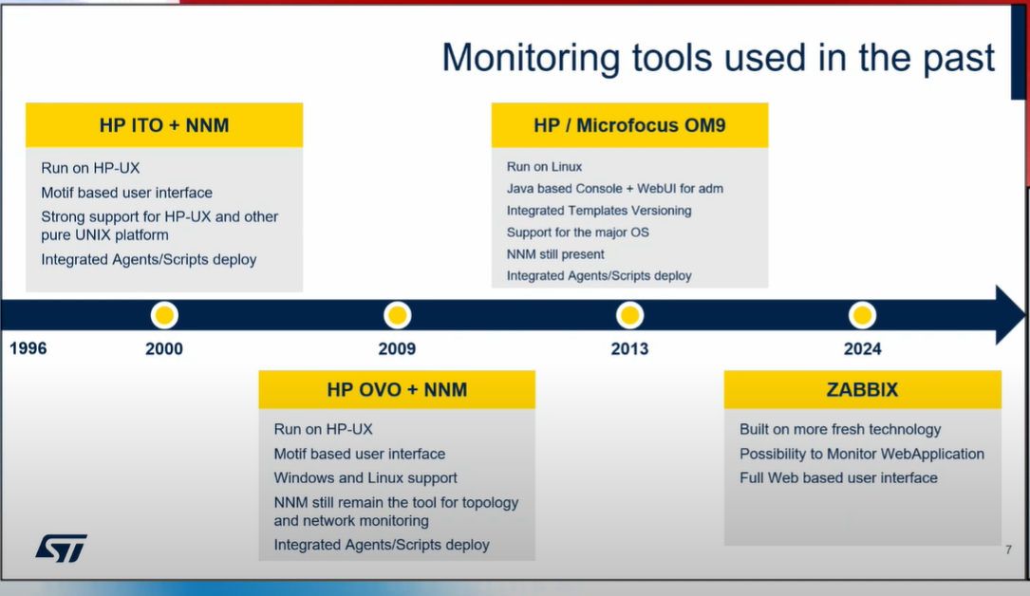
Slide from Zabbix Summit 2025

Slide 5
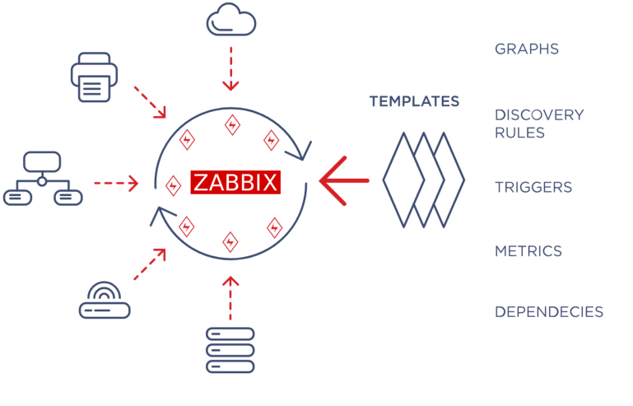
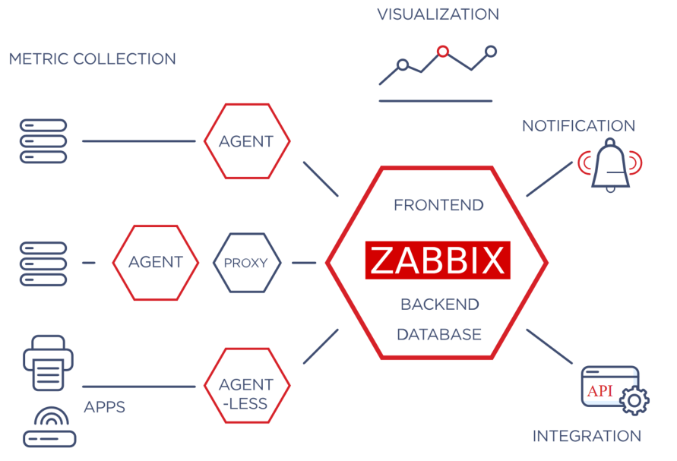
Zabbix components

Slide 6

Basic architecture
Host
Anything you wish to monitor:
  Server
  Switch
  UPS
  Application
  Database
  Website
Agent
Monitoring of devices, resources and applications.
Proxy
Monitoring of distributed locations

Slide 7
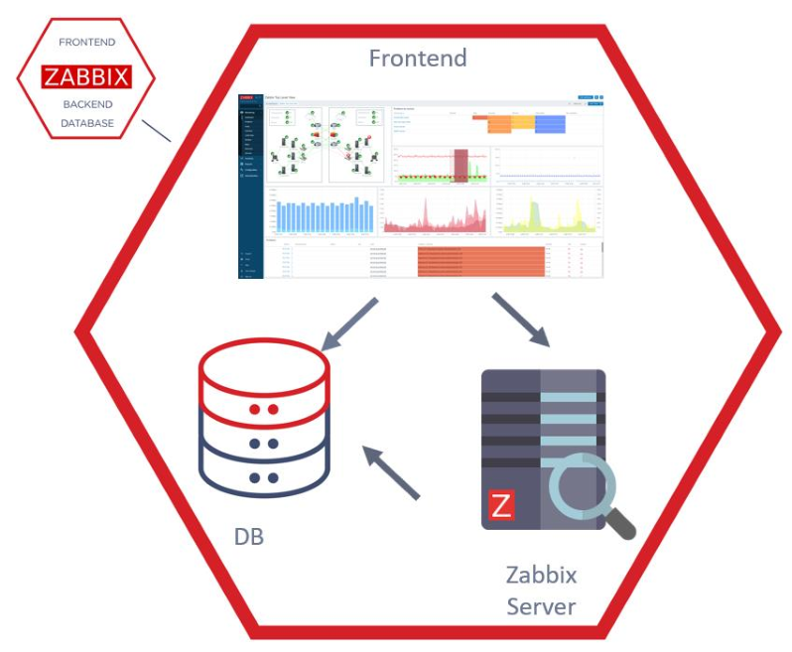
Basic architecture
Server
  Data collection
  Calculating Triggers
  Creating Events
  Notification
Frontend
  Visualization
  Configuration management
Database
  Data storage

Slide 8
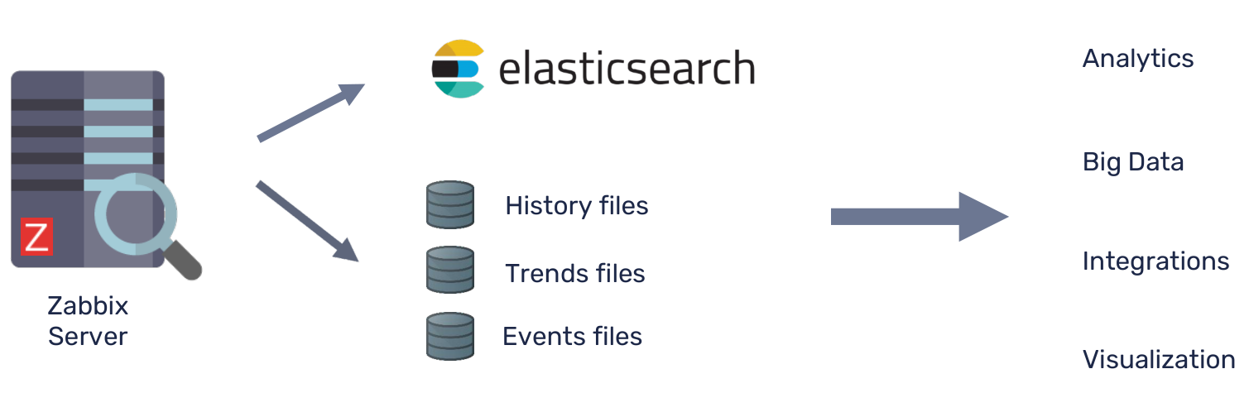
Basic architecture

Slide 9
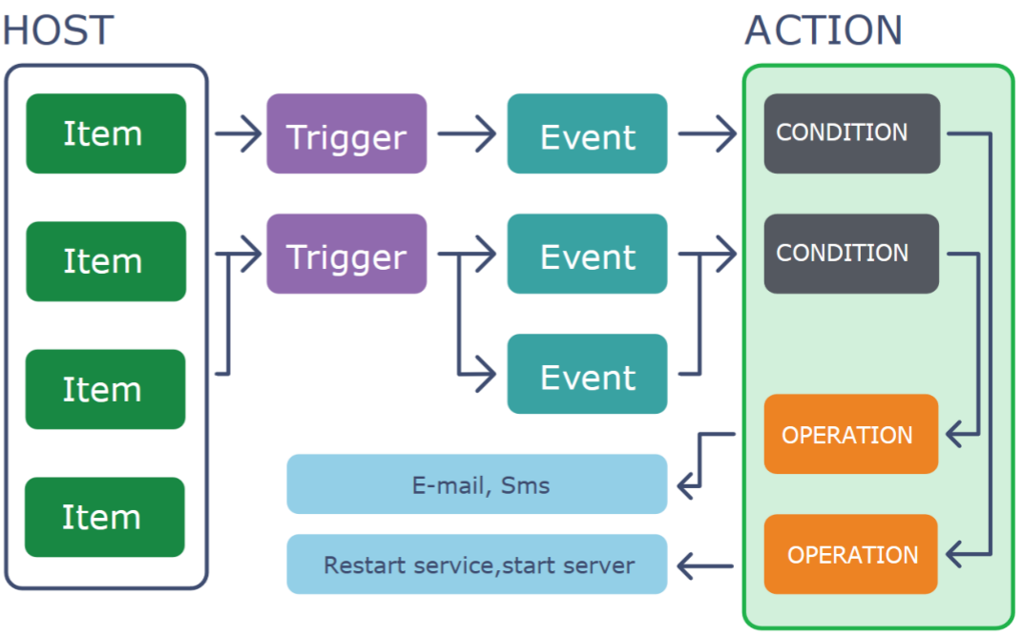
Zabbix components
Host - the device you wish to monitor.
Item - defines a metric which you would like
to monitor:
  DB status
  CPU utilization
  Temperature in a server room
  Number of users online for an application,
  etc.
Trigger – a problem definition.
Event - a single occurrence of something
that deserves attention.
Problem - a trigger that is in “Problem”
state.
Action - a predefined means of reacting to
an event.

Slide 10
System Overview
Access control: monitor changes in room temperature, use of access cards, etc.
KPI monitoring: understand the state of health of your business and make rational decisions by checking collected data against planned numbers: profit, number of web visitors, number of purchases, amount of devices manufactured per hour, etc.
Capacity monitoring: plan your IT budget by measuring performance of IT infrastructure and reporting how much resources remain unused/are missing.
Configuration monitoring: make sure systems work according to rules by checking software versions, installed applications against the allowed ones run on your hardware.
Inventory monitoring: know the actual state of your IT equipment by monitoring licenses, RAM modules, disks, network devices and desktops, printers and other peripherals in actual use and comparing with the official (purchased) inventory.
Security monitoring: exclude security breaches to minimize losses by monitoring network port, malicious software, password files, root password, server case, etc.

Slide 11
Data collection
Services: availability and the responsiveness of e-mail or web servers.
Network devices: network utilization, CPU, memory and port status.
Virtual machines: VMware vCenter and vSphere installations for various VMware hypervisor and virtual machine properties and statistics.
Databases: monitor in great detail any database, including MySQL, PostgreSQL, Oracle and Microsoft SQL Server.
Java Application Server: monitor JBoss, Tomcat, Oracle Application Server or any other application with the efficient Zabbix Java gateway.
Web services: easily monitor availability, response time and download speed of your external website, e-commerce portal or internal wiki and service desk system.
Hardware: gather statistics such as temperature, fan speed voltage, and disk state.
Customized monitoring: integrate ZABBIX in any environment and gather data from financial systems, environment control systems or even sophisticated research devices.

Slide 12
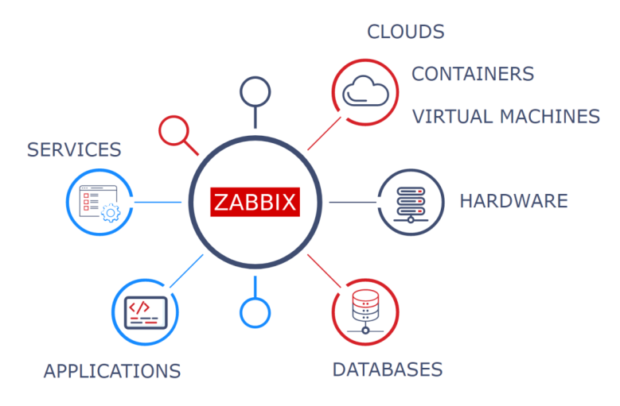

Slide 13
Data collection
Zabbix Agent can work on different platforms and collect metrics from any device or application on performance and availability.
Zabbix Agent supports active/passive checks, is highly efficient and extendable via custom parameters, modules or scripts.
What if agent is not an option?
  SNMP, HTTP, IPMI and SSH agents
  Agentless monitoring
  Databases and Java applications
  monitoring
  Custom metrics/scripts
  Aggregation and calculated checks
  VMware monitoring
  Web monitoring

Slide 14
OS level monitoring
WINDOWS & LINUX
Average CPU load for the machine 1min, 5min and 15min with line graph
Disk utilization for all the partitions or mount point and NFS/SAMBA shares with pie graph
Number of process running and other background tasks information
Traffic of Network Interfaces attached to the VM
All windows services listed under services.msc automatically added to the list of monitored items
Custom service running on a user-defined or service specific port number defined by OEM
Able to run custom scripts to get real time values/data as a part of active checks
Log file analysis and monitoring
OS version and other static information
Trigger Information:
80% utilization of RAM, CPU and all disks is treated as Average(Warning) level
Above 90% utilization of RAM, CPU and all disks is treated as Critical level
Trigger can be created for high network traffic

Slide 15
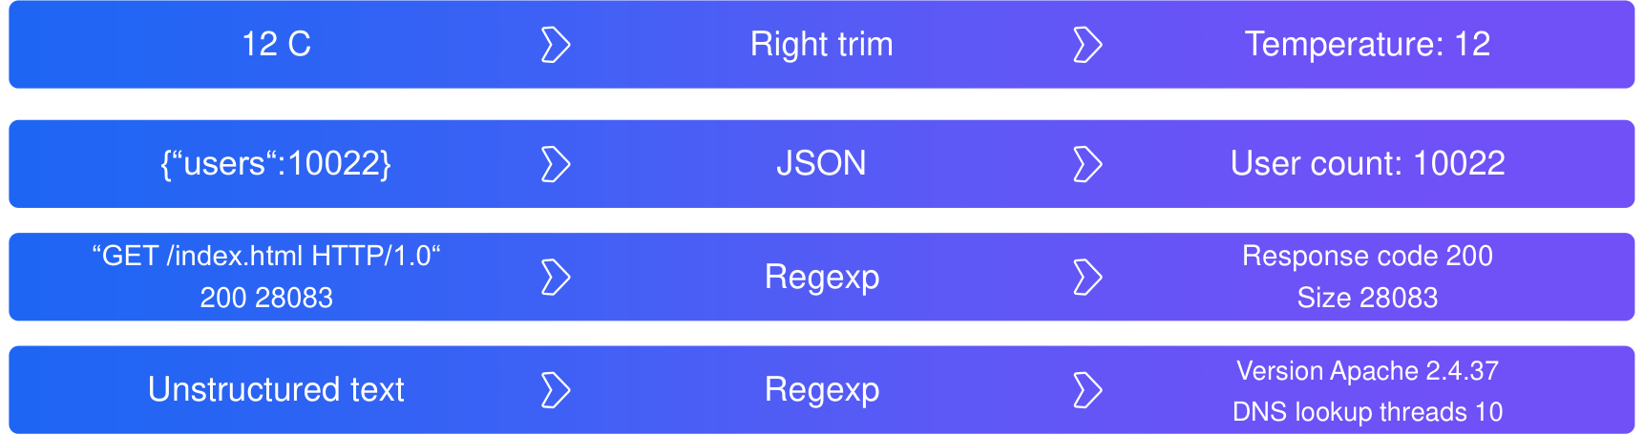
Data collection: Pre-processing

Slide 16
Visualization
Widget-based dashboards
Graphs
Network maps
Geographical maps
Slideshows
Drill-down reports
Latest Data:
All values in the database are stored as raw and averaged data.
The refresh interval and the storage time is set for each data item separately (or automated through a template).
Automatic database cleaning from old data.

Slide 17
Visualization: Graphs
A standard graph for a numeric item is available without any configuration at all - these graphs are generated on runtime.
In a custom graph data of several items can be compared and you can specify the graph style, or the way lines are displayed.
Ad-hoc graphs - create a comparison graph for multiple items with little effort and no maintenance.
Graph - dashboard widget allows to add data sets and define their visual representation.

Slide 18
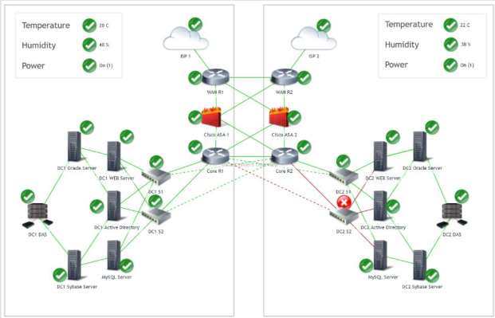
Visualization: Maps
Zabbix network maps offer a possibility of laying out the monitored environment over an optional background image for a user-friendly overview. Each element on the map may represent a host, host group, single trigger, an image or another map.

Slide 19
Visualization: Dashboards
Zabbix Dashboard is a central place in the web frontend that provides personalized details about the monitored environment:
Drill-down reports
Maps
Graphs
Screens
Problems
System status
Host status
Status of Zabbix server
Discovery status
Web

Slide 20
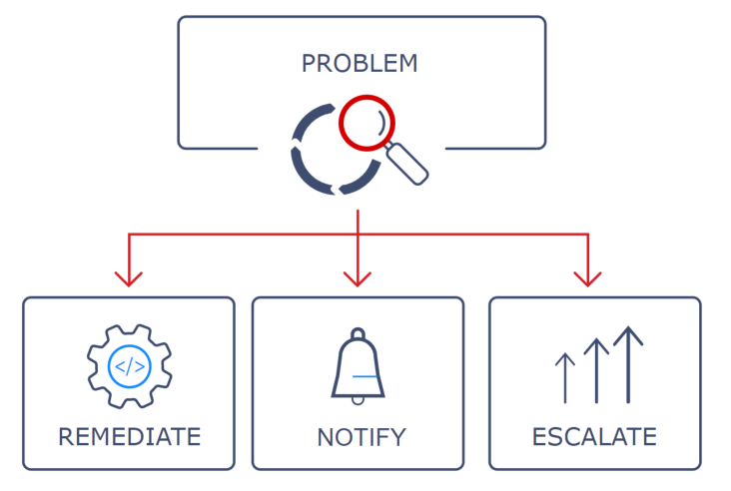
Alerting & notifications
Be notified in case of any issues using different channels:
Send messages
Let Zabbix fix issues automatically
Escalate problems according to flexible user-defined Service Levels
Customize messages based on recipient's role
Customize messages with runtime and inventory information

Slide 21
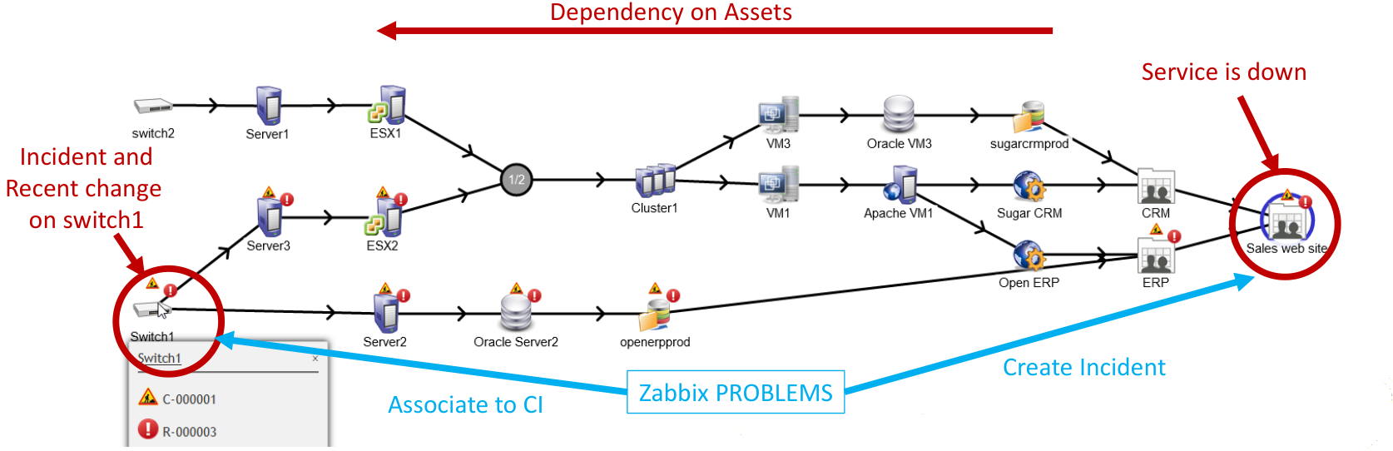
Flow of incident creation

Slide 22
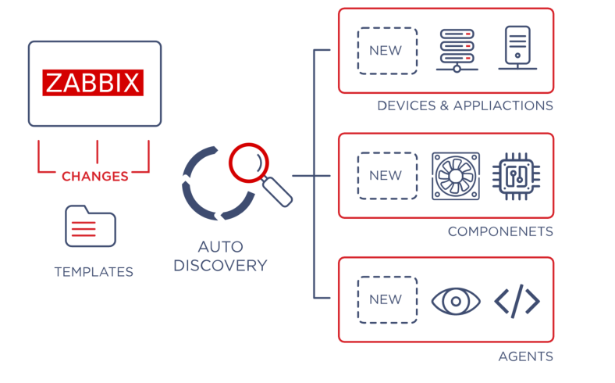
Auto-discovery

Slide 23
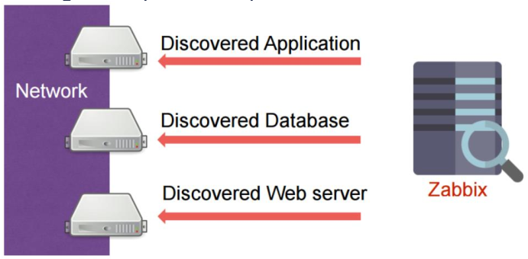
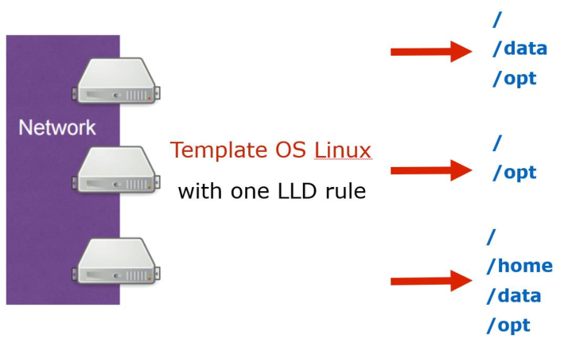
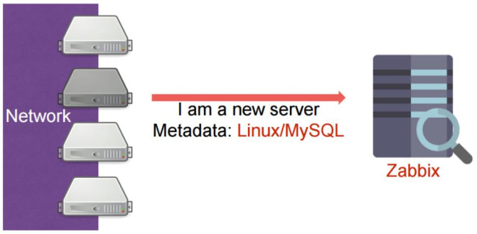
Auto-discovery
Network discovery: periodically scans the network to detect changes and performs specified actions.
Agent auto-registration: configure automatized monitoring of new equipment with Zabbix agents installed.
Low-level detection: automatically creates data items,
triggers and graphics on the host.

Slide 24
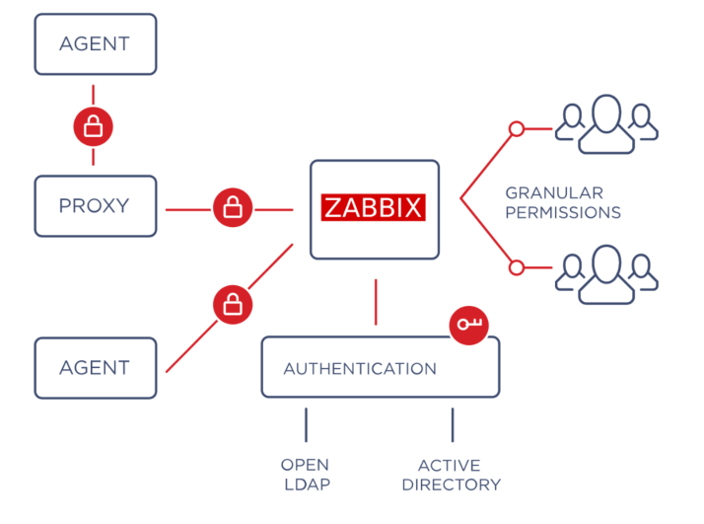
Security
Strong encryption between all Zabbix components
Multiple authentication methods: Open LDAP,
Active Directory, SAML
Flexible user permission schema
Zabbix code is open for security audits

Slide 25
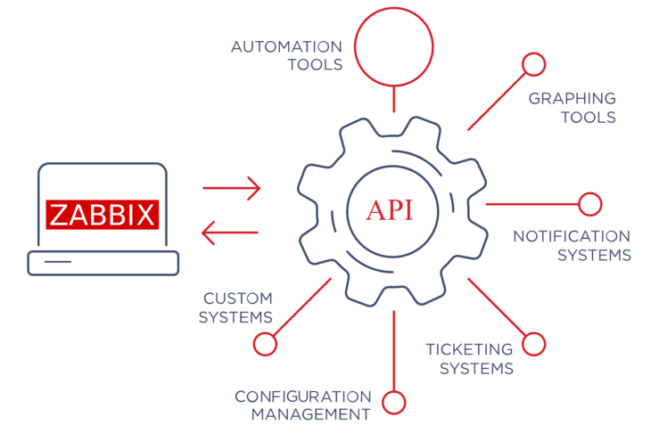
Zabbix API
Integrate Zabbix with any part of your IT environment.
Get access to all Zabbix functionality from external applications through Zabbix API:
Automate Zabbix management via API
Create new applications to work with Zabbix
Integrate Zabbix with third party software: Configuration management, ticketing systems
Retrieve and manage configuration and historical data

Slide 26
Thank you for listening !!
Time for Q&A session.

