Slide 1

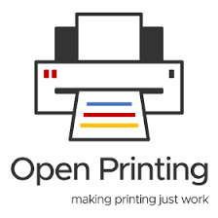
OOSC 4.0 · IIIT ALLAHABAD
From Prompt to Pull Request
My journey into open source and responsible
AI-assisted contributions
Ayush Singh
Maintainer @openpriniting | OSS @TheLinuxFoundation | System Engineer | 60+ Pr | Author “ The Last Manual Merge”
Lucky Tiwari
Cybersecurity Specialist | Network & Security Engineer | Co-author
Notes:
Welcome the room. Quick personal hook: a year ago I sat in this same conference as a first-time attendee with almost no contribution experience. Today I'm back on stage to share what changed in twelve months, and how AI tools fit responsibly into that journey. Introduce co-speaker Lucky briefly.

Slide 2
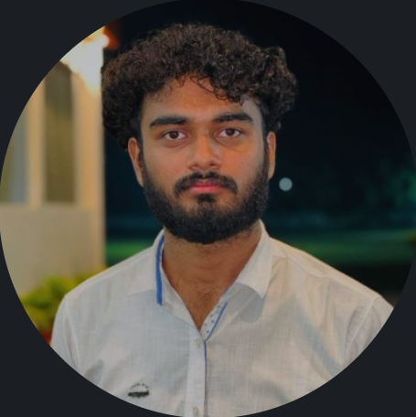
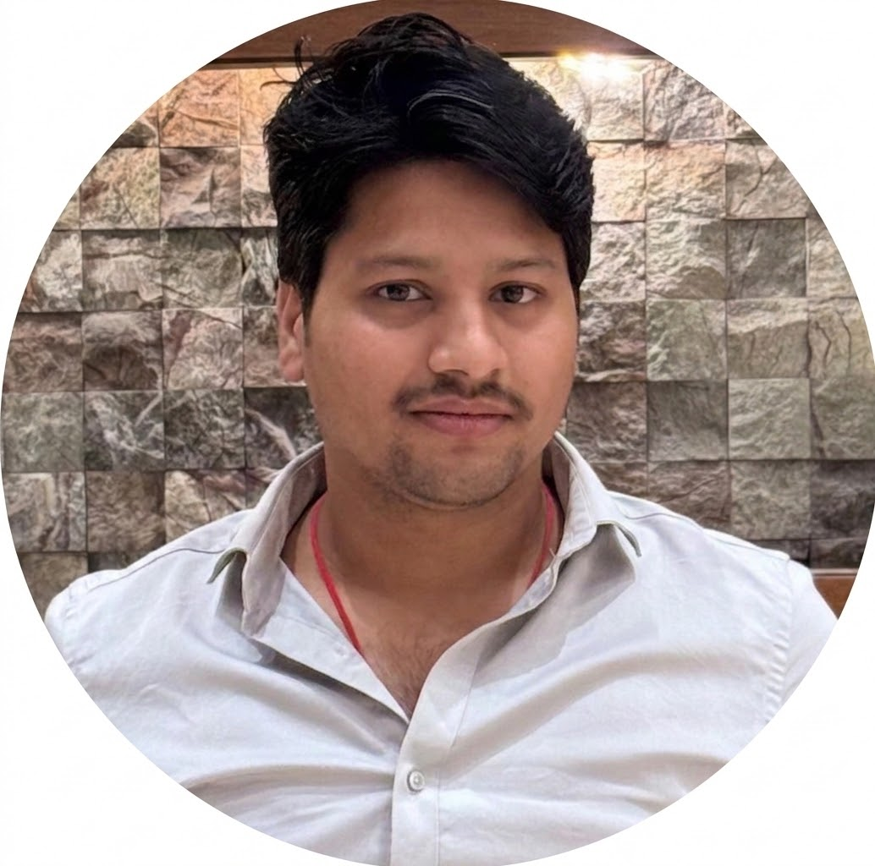

ABOUT THE SPEAKERS
02
Who's talking to you today
Ayush Singh
Lucky Tiwari
System Engineer || Maintainer (legacy-driver)
Network & Security Engineer
From writing my first lines of code to maintaining real open-source projects, my journey has been about learning by building. I’m an OpenPrinting maintainer, OSS contributor at The Linux Foundation, and System Engineer with 60+ PRs merged. I also write about the things I learn, including The Last Manual Merge.
Passionate about cybersecurity and building secure systems. Working across network and security engineering while exploring real-world challenges in technology. Cybersecurity Specialist | Network & Security Engineer | Co-author
Two people. One practical workflow.
Notes:
Quick intros — keep this under a minute. Ayush covers his own bio fast, then hands to Lucky for a 20-second self-intro and to say what part of the talk / demos they own. Replace the placeholder card with Lucky's real bio before presenting.

Slide 3

THE ORIGIN STORY
03
“A year ago, I sat
where you’re sitting now.”
I attended Opportunity Open Source as a participant — inspired by the people building and maintaining the software we all rely on, but with almost no contribution experience of my own.
“I had questions. I didn’t have context.”
Notes:
Set the emotional anchor of the talk. This is the 'why should you care' moment — you were exactly where the audience is, one year ago. Keep this slide slow; let it land before moving on.

Slide 4
ONE YEAR LATER
04
What changed in twelve months
9+
LFC102
1
merged pull requests
OpenPrinting · Linux Foundation
Linux Foundation
certified
talk today
1
Hacktoberfest 2025
Super Contributor
Same conference.
Same room.
A completely different relationship with open source.
60+
Overall merged pull requests
OpenPrinting · Linux Foundation · Medic · wpring
Notes:
Ground the story in concrete numbers before pivoting into the AI discussion. These are the credentials that let the audience trust the practical advice coming next.

Slide 5
MEANWHILE
05
AI coding assistants
went mainstream.
ACCELERANT
OR
NOISE?
They explain unfamiliar code, suggest implementations, and generate tests. But they can also encourage low-quality contributions when used without understanding the project.
That tension is the point of this talk.
Notes:
Transition slide. Frame the tension this talk lives in: AI as accelerant vs. AI as a source of low-quality noise for maintainers.

Slide 6
THE UPSIDE
06
Where AI genuinely
accelerates learning
01
Explains unfamiliar code
Turns a 5,000-line codebase you've never seen into something you can reason about in minutes.
02
Suggests implementations
Gives you a first draft to react to, instead of a blank file and a blinking cursor.
Important :
03
Generates tests
Be cautious, and double verify the information
Lowers the activation energy for covering edge cases you might otherwise skip.
04
Speeds up onboarding
Helps first-time contributors get productive faster on projects with steep learning curves.
Notes:
Give the audience genuine credit for wanting to use AI — this isn't an anti-AI talk. Use a quick live example if time allows: paste an unfamiliar OpenPrinting function and show an assistant explaining it.

Slide 7
THE RISK
07
Where AI can mislead contributors
A plausible answer is not the same thing as a project-correct answer.
01
Suggests changes without understanding the project's architecture
02
Ignores unwritten conventions maintainers expect contributors to know
03
Produces plausible-looking code that breaks project-specific constraints
04
Encourages volume over understanding — quantity of PRs over quality
Notes:
This is the maintainer's-eye view. Consider quoting (paraphrased, not verbatim) a review comment pattern you've actually seen on OpenPrinting PRs — 'this doesn't match how we handle X elsewhere in the codebase' type feedback.

Slide 8
CASE STUDY
08
From an AI suggestion
to a merged PR
go-mfp · discovery package · with collaborator Alex
01
02
03
04
05
Prompt
AI draft
Verify
Review
Merged
Asked an AI assistant to help implement a piece of discovery logic.
Plausible first pass. Wrong assumptions about the package.
Cross-checked code, tests, and maintainer conventions.
Feedback reshaped the contribution to fit the project.
The final PR looked meaningfully different from the AI draft.
Notes:
This is your strongest slide if you show the real diff or PR link live instead of reading bullets. Pull up the actual go-mfp PR in a browser tab as backup. Loop Lucky in here if they were part of this contribution.

Slide 9
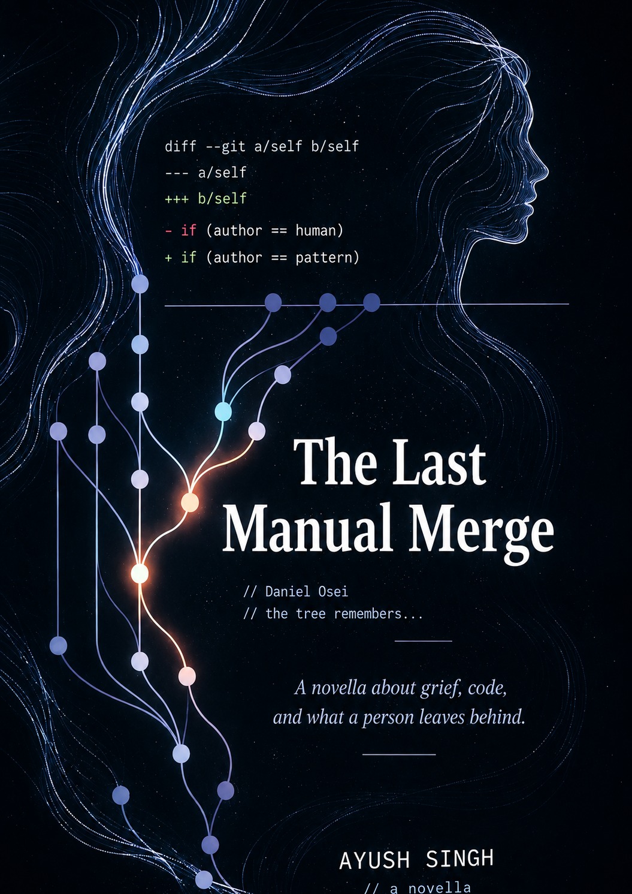
COMMON PITFALLS
09
Why AI-generated PRs
get rejected
×
No linked issue or unclear motivation
×
Style and formatting don't match the project's conventions
The failure is rarely “AI wrote code.”
It is “the contributor stopped owning the work.”
×
Missing or superficial tests
×
Reinvents logic that already exists elsewhere
“The Last Manual Merge”
×
Commit messages don't explain the why
×
Contributor can't answer follow-up questions
— Ayush Singh
Available on Pothi.com
Notes:
These should feel like patterns you've genuinely watched play out reviewing or submitting PRs — ground each one in a one-sentence real memory if you can, even without naming the PR.

Slide 10
THE OTHER SIDE OF THE TABLE
10
How maintainers actually
evaluate a contribution
Does it fit?
Is it trustworthy?
Is it respectful?
Matches architecture
Follows naming & style
Doesn’t duplicate logic
Tests cover the change
Clear commit history
You understand your own diff
Small, reviewable scope
References an issue/discussion
Responsive to feedback
Proof :
Being Maintainer myself i understand and know that how maintainer review the code.
Notes:
This is the maintainer mental checklist, translated for contributors. Frame it as: if you can honestly tick these boxes before opening the PR, your acceptance odds go way up regardless of whether AI helped write the code.

Slide 11
THE FRAMEWORK
11
From prompt to pull request, responsibly
01
Understand
Read the issue, the codebase area, and existing patterns before prompting anything.
AI is
a step
inside
the
workflow.
02
Prompt
Use AI for drafts, explanations, and test scaffolding — with real project context.
03
Verify
Check the output against conventions, run it, and read every line you didn’t write.
04
Own it
Write your own PR description and commit messages — defend every decision.
Notes:
This is the slide the audience should photograph. Say it plainly: AI is a step inside your workflow, never the whole workflow.

Slide 12
PRACTICAL TAKEAWAYS
12
A cheat sheet for
AI-assisted contributing
✓
Read the contributing guide before writing a single line
✓
Treat every AI suggestion as a draft, never a final answer
✓
Start with small, well-scoped issues — not ambitious rewrites
✓
Write PR descriptions and commit messages yourself
✓
Ask AI to explain code, not just generate it
✓
Engage with review feedback like a conversation, not a gate to pass
Notes:
Deliver this fast and concretely — it's the 'what do I do Monday morning' slide. Consider inviting Lucky to add one item from their own experience.

Slide 13
CLOSING THE LOOP
13
What a year at OpenPrinting
taught me
★
Maintainers are protecting a codebase for long-term health, not gatekeeping for its own sake
★
Small, well-understood PRs earn trust faster than large, impressive-looking ones
TRUST
is built
line by
line.
★
AI is most useful as a learning partner — for understanding, not for shortcuts
★
The best contributions come from contributors who could explain their PR line by line
Notes:
Bring the talk back to the human takeaway before the thank-you slide. This is the emotional close, mirroring the origin story from slide 3.

Slide 14

Thank you.
Questions, PR reviews, or your own first-contribution story.
Ayush Singh
Lucky Tiwari
Maintainer @openpriniting | OSS @TheLinuxFoundation | System Engineer | 60+ Pr | Author “ The Last Manual Merge”
Cybersecurity Specialist | Network & Security Engineer | Researcher | Co-author | Collaborator @MoodBite.Ai | Founding Member @Mentor.ai
OpenPrinting · github.com/OpenPrinting · Talk resources shared after the session
OOSC 4.0 · IIIT Allahabad
Notes:
Leave contact details up during Q&A. If time allows, invite one live question about a specific PR someone in the audience is stuck on.

