Slide 1

OOSC 4.0 · IIIT ALLAHABAD
Aug 29, 2026 · 6:05 PM · Room 1
From Zero to Open Source
The roadmap every beginner wishes they had
Talk (40 min) · Community track · Beginner-friendly
Speakers
Saksham Tiwari · Aman Mishra · Ayush Singh · Shivam Gupta

Slide 2



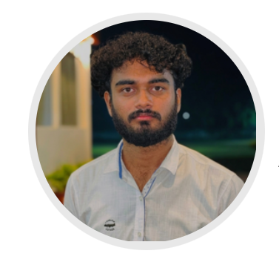
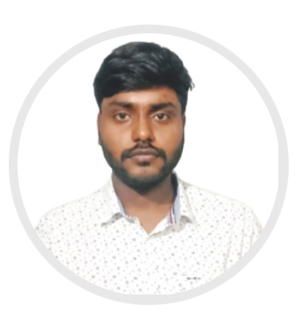
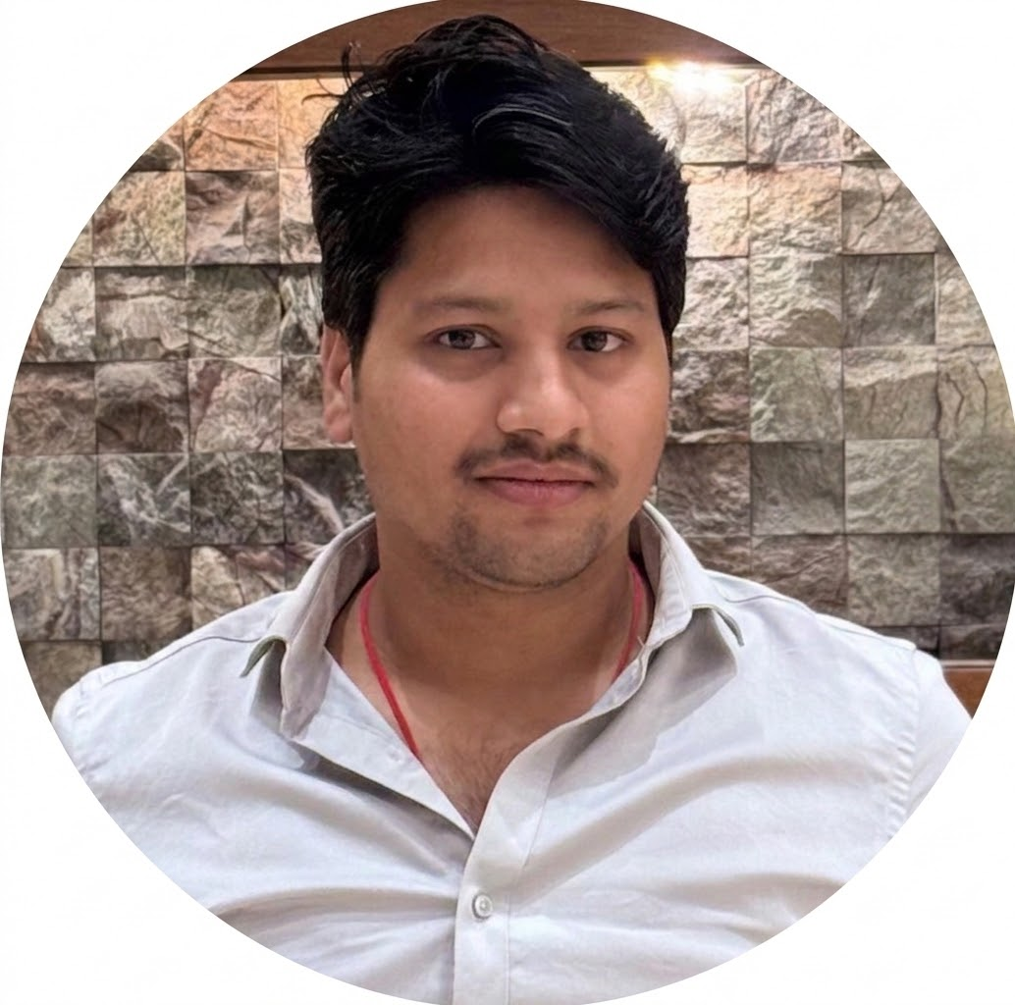
01 ABOUT THE SPEAKERS
Who's talking to you today
ST
AM
SG
Saksham Tiwari
Aman Mishra
Ayush Singh
Mr Shivam Gupta
Contributor @Kornia· Python Developer
· DevSecOps · Collaborator @Moodbite.ai
CS graduate · Open source contributor, OpenPrinting
Maintainer @OpenPrinting · OSS @The Linux Foundation · System Engineer · 60+ PRs · Author, “The Last Manual Merge”
Open Source Contributor
@OpenPrinting, @legacy-driver
OOSC 4.0 · IIIT ALLAHABAD
02

Slide 3
02 THE CHALLENGE
Where most beginners get stuck
Every year, thousands of students discover open source with excitement — then abandon their journey after hitting the same wall.
Confusing documentation
Unfamiliar tools & workflows
Large, intimidating codebases
Fear of making mistakes
“The biggest challenge isn’t writing code — it’s knowing where to begin.”
OOSC 4.0 · IIIT ALLAHABAD
03

Slide 4
03 THE ROADMAP
Six milestones from zero to your first PR
01
Set up Git & GitHub
02
Choose the right project
03
Understand the repo structure
04
Find a beginner-friendly issue
05
Submit your first pull request
06
Collaborate with maintainers
OOSC 4.0 · IIIT ALLAHABAD
04

Slide 5
04 STEP 1
Git, GitHub & repository basics
Setting up Git & GitHub
Install Git, configure your identity, and create a GitHub account — the two tools every contribution starts with.
Reading a repository
Learn to navigate a README, folder structure, issues, and pull requests before touching any code.
OOSC 4.0 · IIIT ALLAHABAD
05

Slide 6
05 STEP 2
Choosing a project & finding your first issue
Choosing the right project
Pick a project that matches your interests and skill level — not the biggest or most popular one.
Finding beginner-friendly issues
Look for “good first issue” and “help wanted” labels to find meaningful, low-risk entry points.
OOSC 4.0 · IIIT ALLAHABAD
06

Slide 7
06 STEP 3
From pull request to merged contribution
Submitting your first PR
Write a clear description, keep the change small, and link the issue it resolves.
Collaborating with maintainers
Respond to code review like a conversation — ask questions, iterate, and stay engaged until it merges.
OOSC 4.0 · IIIT ALLAHABAD
07

Slide 8
07 CASE STUDY
OpenPrinting: zero to valued contributor
A real-world example of the roadmap in action — showing how consistent learning, curiosity, and community engagement turn a complete beginner into a valuable contributor.
Consistent learning
Curiosity
Community engagement
https://github.com/openprinting
OOSC 4.0 · IIIT ALLAHABAD
08

Slide 9
08 THE MINDSET
It’s not about tools. It’s about habits.
01
02
03
04
Mindset
Communication
Problem-solving
Consistency
Rather than complex tools or advanced programming, long-term success in open source comes from these habits.
OOSC 4.0 · IIIT ALLAHABAD
09

Slide 10
09 KEY TAKEAWAYS
What you’ll leave with
How to choose the right project as a beginner
Understanding Git, GitHub & OSS workflows
Finding beginner-friendly issues
Communicating with maintainers
Overcoming common beginner challenges
Habits for long-term OSS success
OOSC 4.0 · IIIT ALLAHABAD
10

Slide 11
Thank you.
Every experienced contributor once started from zero.
Speakers
Saksham Tiwari · Aman Mishra · Ayush Singh · Shivam Gupta
OOSC 4.0 · IIIT Allahabad

