Slide 1

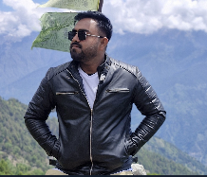
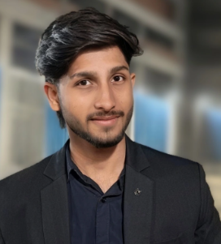
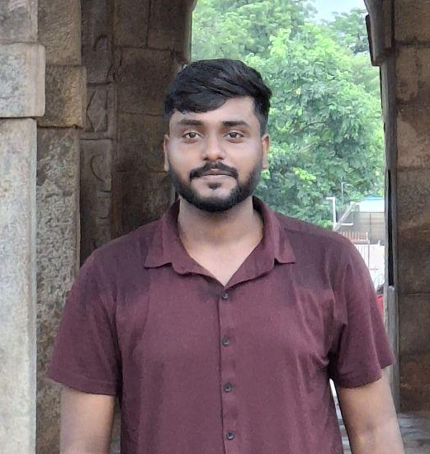
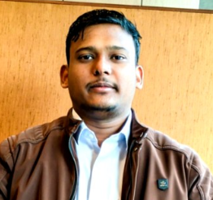
OOSC 4.0 • IIIT ALLAHABAD
AI Overload
How careless AI usage is
quietly hurting pull request quality
Speakers of This Panel
AI + OPEN SOURCE
Aman Mishra | Saksham Tiwari | Shivam Gupta | Pankaj Kumar
August 30, 2026 • 40 minutes
Notes:
AYUSH — SAY
“How many of you use AI while coding?”
“Today, we are not saying AI is bad.”
PANKAJ — SAY
“We want to ask a different question: when does AI assistance become a problem?”

Slide 2
OPENING
02
Do you use AI while contributing to open source?
RAISE YOUR HAND
Never
Sometimes
Often
Almost always
Notes:
AYUSH — SAY
“Quick show of hands.”
ASK AUDIENCE
Raise your hand: Never / Sometimes / Often / Almost always.
PANKAJ — SAY
“There is no right answer.”

Slide 3
OPENING
03
When does AI assistance become AI dependence?
THE QUESTION
AI can help us write code.
Who is responsible for understanding it?
~1 min
Notes:
AYUSH — SAY
“This is the question for the whole talk.”
PANKAJ — SAY
“The tool can generate. The contributor still owns the change.”

Slide 4
THE PROBLEM
04
Two ways to approach the same issue
WITHOUT MUCH AI
AI-HEAVY
Issue
Research
Understand
Code
Test
PR
Issue
Prompt
Generate
Copy
PR
→
→
→
→
→
→
→
→
→
Fast is useful. Context is useful too.
~2 min
Notes:
AYUSH — SAY
“Which one looks faster?”
ASK AUDIENCE
Take two quick answers.
PANKAJ — SAY
“And which one keeps more understanding with the contributor?”

Slide 5
THE PROBLEM
05
AI is not the villain
The problem is careless use.
LEARN
HELP
SUBMIT
Explain code
Find docs
Explore ideas
Boilerplate
Small refactors
Test ideas
Whole feature
Whole PR
“Fix everything”
Same tool. Very different level of responsibility.
~2 min
Notes:
AYUSH — SAY
“AI is useful for learning and productivity.”
PANKAJ — SAY
“The risk starts when we stop checking and start submitting.”

Slide 6
THE PROBLEM
06
A contributor and a maintainer see different things
CONTRIBUTOR
MAINTAINER
“The code works.”
“Should this be here?”
• Tests pass
• Project style
• Scope
• Task completed
• Architecture
• Code works
• Maintenance
• Future changes
~2 min
Notes:
AYUSH — SAY
“As contributors, we often stop at: it works.”
PANKAJ — SAY
“Maintainers also think about the project around the change.”

Slide 7
PR LAB
07
Would you merge this?
Fix config loading
YOUR VOTE
PR #184
+184 −12 • 6 files changed
YES / NO
● ● ●
def load_config(path):
config = read_file(path)
if not config:
First look only.
Don't overthink it.
return {}
return normalize(config)
# Normalize everything
~2 min
Notes:
AYUSH — SAY
“First look only. Would you merge this?”
ASK AUDIENCE
Raise hands: YES / NO.
PANKAJ — SAY
“Just vote from what you can see.”

Slide 8
PR LAB
08
Now look closer
● ● ●
Unnecessary change
def load_config(path):
config = read_file(path)
Project pattern ignored
if not config:
return {}
return normalize(config)
Generic comment
# Normalize everything
Tests miss real behavior
~2 min
Notes:
AYUSH — SAY
“At first glance, it looks fine.”
PANKAJ — SAY
“But scope, project patterns, and tests tell a different story.”

Slide 9
PR LAB
09
Working code is not the same as a good contribution
Correctness
Context
Project conventions
Maintainability
GOOD PR
A maintainer reviews the change inside the project.
~2 min
Notes:
AYUSH — SAY
“Correctness matters.”
PANKAJ — SAY
“But open source also needs context, fit, and maintainability.”

Slide 10
PR LAB
10
Have you seen any of these?
Huge change
for a small issue
Generic comments
everywhere
New abstraction
without a clear need
Different style
from nearby code
PR text
does not match the diff
WHO HAS SEEN THIS?
~2 min
Notes:
AYUSH — SAY
“Which one have you seen before?”
ASK AUDIENCE
Take a few quick reactions.
PANKAJ — SAY
“These are warning signs, not proof that AI was used.”

Slide 11
PR LAB
11
The PR that makes everyone ask: “Why?”
PROMPT
200 lines
generated
Tests
pass
PR
opened
Maintainer:
Why?
AI said so
→
→
→
→
→
The warning sign: the contributor cannot explain the change.
~2 min
Notes:
AYUSH — SAY
“It is funny until it becomes a review problem.”
PANKAJ — SAY
“If the contributor cannot explain the change, trust drops quickly.”

Slide 12
THE LINE
12
How much AI is too much?
LEARNING
SUBMISSION
Explain code
Find docs
Brainstorm
Boilerplate
Whole feature
Complete PR
Where would you draw the line?
~2 min
Notes:
AYUSH — SAY
“There is no magic percentage.”
ASK AUDIENCE
Ask for two or three answers.
PANKAJ — SAY
“The better question is: does AI help you understand, or replace understanding?”

Slide 13
THE DEBATE
13
Should contributors disclose AI usage?
YES
NO
• Can build trust
• Gives reviewers context
• Useful when AI shapes a large part of the change
• Tool use can be routine
• Project rules differ
• Review should focus on the result too
~2 min
Notes:
AYUSH — SAY
“I lean toward disclosure when AI materially shapes the change.”
ASK AUDIENCE
Vote: YES / NO / IT DEPENDS.
PANKAJ — SAY
“I think project policy matters. But the contributor still owns the result.”

Slide 14
THE DEBATE
14
IF AI WROTE IT
Who owns it?
THE CONTRIBUTOR
AI may generate the code.
The PR still has your name.
~2 min
Notes:
AYUSH — SAY
“AI may generate the code.”
PANKAJ — SAY
“But the PR still has your name. Responsibility stays with you.”

Slide 15
BETTER WORKFLOW
15
Use AI. Don't outsource your thinking.
1
2
3
4
Understand issue
Explore codebase
Use AI to learn
Implement
5
6
7
8
Review generated code
Test
Explain the change
Open PR
The key step is review.
~3 min
Notes:
AYUSH — SAY
“Start with the issue and the codebase.”
PANKAJ — SAY
“Then use AI where it saves time — and review the result yourself.”

Slide 16
BETTER WORKFLOW
16
Good prompts help you understand
“Explain how this module works.”
“What does this function do?”
“What pattern does this project already use?”
“What should I understand before changing this?”
“What edge cases should I test?”
USE AI TO INCREASE UNDERSTANDING
~2 min
Notes:
AYUSH — SAY
“Notice what these prompts have in common.”
PANKAJ — SAY
“They ask AI to explain, explore, and challenge our thinking.”

Slide 17
BETTER WORKFLOW
17
The risky workflow
“Implement this entire issue.”
GENERATE
“Fix everything.”
COPY
“Create the complete PR.”
“Write all tests.”
SUBMIT
Can you explain what you just submitted?
~2 min
Notes:
AYUSH — SAY
“These prompts are not always wrong.”
PANKAJ — SAY
“The problem is when generation becomes the whole workflow.”

Slide 18
SELF-CHECK
18
Before you open the PR
□
Do I understand the change?
□
Can I explain why I chose this approach?
□
Does it match the project's patterns?
□
Did I test the important cases?
□
Did I review the AI-generated code?
□
Can I defend this PR in review?
~2 min
Notes:
AYUSH — SAY
“This is the checklist we want you to remember.”
PANKAJ — SAY
“If one answer is no, pause before opening the PR.”

Slide 19
SELF-CHECK
19
Explain your PR in 30 seconds.
THE 30-SECOND TEST
“What did you change — and why?”
Can you answer without opening ChatGPT?
~2 min
Notes:
AYUSH — SAY
“Imagine a maintainer asks you this.”
ASK AUDIENCE
Silently think about your last PR and answer it in your head.
PANKAJ — SAY
“If you cannot answer, that is a signal to understand the change better.”

Slide 20
CLOSING
20
Three things to remember
01
AI can help you contribute.
02
AI cannot own your contribution.
03
Understanding is still your responsibility.
~2 min
Notes:
AYUSH — SAY
“Three simple points.”
PANKAJ — SAY
“AI helps. You own the contribution. Understanding stays with you.”

Slide 21
OOSC 4.0 • FINAL QUESTION
Before opening your next PR:
“Do I understand what I'm submitting?”
AYUSH
AI can write code faster than us.
PANKAJ
But faster code isn't always a better contribution.
AYUSH
Use AI.
PANKAJ
Question it.
AYUSH
Review it.
BOTH
Own your contribution.
Thank you • Ayush Singh & Pankaj Kumar
Notes:
AYUSH — SAY
“AI can write code faster than us. Use AI.”
PANKAJ — SAY
“But faster code is not always a better contribution. Question it. Review it.”
“Own your contribution.”

