Slide 1
AUG 30, 2026 // ROOM 1 // some amount of MINUTES man
Viewing Beyond the
MAD Landscape
with my open source journey
AI got all the attention.
The pipes carrying it did not.
Sankalp Jha
GSoC 2025 // P4 Language Consortium
Notes:
Open cold. Do not read the slide.
Line to land: everyone in this room has an opinion about AI. Almost nobody has an opinion about the wire it runs on. That is what I want to talk about for 20 minutes.
Talk title is the one on the schedule, so it matches the programme.

Slide 2







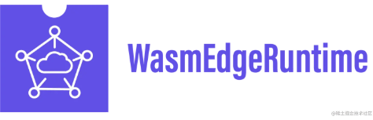

WHO IS TALKING
Where I have been hanging out
GSoC 2025 with P4. Merged patches in HAMi, WasmEdge and bpfilter. Still poking at the rest.
Google Summer of Code 2025
P4 Language Consortium
P4 is a Linux Foundation project
SpliDT, research out of Stanford
Intel Tofino, my target ASIC
facebook/bpfilter, eBPF firewall
Project-HAMi, CNCF
WasmEdge, CNCF
KubeEdge, CNCF
Notes:
Fifteen seconds, no more. Point, do not narrate.
Defensible claims: GSoC 2025 contributor with P4 Language Consortium (SpliDT). P4 is a Linux Foundation project (P4.org moved to ONF in 2019, ONF projects graduated to LF). SpliDT is Stanford-originated research. Intel Tofino was the target ASIC. facebook/bpfilter is Meta's eBPF packet filtering framework, PR #507 merged. Project-HAMi is CNCF (Incubating). WasmEdge is CNCF sandbox. KubeEdge is CNCF incubating.
If asked about KubeEdge specifically, answer from your own involvement. The slide only names the project.

Slide 3

WHO IS TALKING
The Three Musketeers
Abhishek Kumar- LFX’25 Mentee at KubeEdge, GSoC’26 at UN and ICPC’25 Regionalist
Akarsh Sahlot- LFX’25 (Mentee and Maintainer) at Hyphae(OpenSSF+Sony CSL)and GSoC’26 at CERN
and me
Notes:
Fifteen seconds, no more. Point, do not narrate.
Defensible claims: GSoC 2025 contributor with P4 Language Consortium (SpliDT). P4 is a Linux Foundation project (P4.org moved to ONF in 2019, ONF projects graduated to LF). SpliDT is Stanford-originated research. Intel Tofino was the target ASIC. facebook/bpfilter is Meta's eBPF packet filtering framework, PR #507 merged. Project-HAMi is CNCF (Incubating). WasmEdge is CNCF sandbox. KubeEdge is CNCF incubating.
If asked about KubeEdge specifically, answer from your own involvement. The slide only names the project.

Slide 4
THE REFRAME
To us, networking meant ping
IN YOUR ROOM
IN A DATA CENTRE
Latency, download speed, lag in a match.
Annoying when it is bad. Invisible when it is good.
A comfort feature.
The same wire decides whether ten thousand GPUs are working or waiting.
Not a comfort feature.
The ceiling.
Same word. Different building. Completely different stakes.
Notes:
This is the pivot of the whole talk. Slow down here.
Start with the room they already understand, then move the same word into a data centre. Do not defend it yet, slide 4 and 5 do that.

Slide 5
THE SHAPE OF THE PROBLEM
The compute is fine. The path is not.
every gradient sync crosses this
GPU
NIC
SWITCH
NIC
GPU
compute
waiting
Training one large model is thousands of these round trips per second. While the path is busy, the expensive silicon on both ends is idle.
So the interesting question stops being how fast the chip is, and becomes what happens in the middle.
Notes:
Draw the line with your hand, left to right, then stop on the switch.
Point: the two ends of this picture get all the funding and all the news coverage. The middle gets neither.

Slide 6
TWO NUMBERS WORTH REMEMBERING
945 TWh
over half
IEA base case for global data centre electricity by 2030. Roughly double 2024, and just under 3 percent of all electricity on earth.
of step time spent on communication, not computation, in profiled large model training runs. Not a fringe case.
source: IEA, Energy and AI (2025)
source: arXiv 2411.15871, Megatron-LM profiling
Power is now a hard constraint, and a large slice of what that power buys is spent waiting.
Notes:
Be precise if challenged.
945 TWh: IEA Energy and AI report, base case, global data centre electricity by 2030, roughly double the ~415 TWh of 2024, just under 3% of global electricity. A later IEA update gives 485 TWh (2025) to ~950 TWh (2030). Either way, doubling.
Over half: arXiv 2411.15871 profiled Megatron-LM on a 64-card A40 cluster; for Llama-39B, tensor and context parallel communication was 55% of execution time. Meta has separately shown time-in-network reaching up to ~50% of workload time. Say 'in profiled configurations', not 'always'.
Do not claim networking equipment is the majority of data centre power. It is not, it is roughly 5%. The argument is about wasted GPU time, not about switch wattage.

Slide 7
THE THING NOBODY PUT ON A BILLBOARD
AI moved the goalposts on efficiency
UNTIL RECENTLY
NOW
Is the output good?
Good per watt.
Per GPU-hour.
Per byte moved.
Throw hardware at it. Hardware was cheap and nobody counted watts.
AI did not create this waste. It made it expensive enough that people finally started measuring it.
That is the useful thing AI gave systems engineering. Not the demos. The pressure.
Notes:
This is the least obvious point in the talk and the one worth the most.
The argument is not anti-AI. It is that a decade of 'just add more machines' ended, and constraint is what makes engineering interesting again.

Slide 8
ONE IDEA, THREE PLACES
So people started programming the pipes
THE SWITCH
THE KERNEL
THE RUNTIME
P4
eBPF
HAMi, Wasm
Write the forwarding logic of the chip itself.
Run verified programs inside Linux without patching it.
Slice the scarce resource instead of handing out whole ones.
Same move every time. Stop routing around fixed infrastructure. Make the infrastructure itself programmable.
Notes:
Signpost slide. Tell them the next three slides are these three boxes in order.
Do not explain each box here, you explain them next.

Slide 9
LAYER 1 // THE SWITCH
P4: the chip stops being a black box
packet in
packet out
PARSER
MATCH
+ ACTION
MATCH
+ ACTION
DEPARSER
you write all of this
Protocol independent. The chip does not know what IP is until you tell it.
Target independent. The same program compiles to ASICs, FPGAs, NICs and software switches.
A Linux Foundation project. Created 2013, open, and boringly well documented.
Notes:
Claims you can defend: P4 was created in 2013; it is protocol independent and target independent by design (compiles to ASICs, FPGAs, CPUs, NPUs, software switches); P4.org joined ONF in 2019 and P4 is now an independent project under the Linux Foundation.
The parser / match-action / deparser picture is the standard P4 pipeline abstraction (PISA). Keep it at that level, do not promise exact stage counts for a specific chip.

Slide 10
GSoC 2025 // SpliDT
The problem: a tree does not fit in a pipeline
WHAT ML WANTS
WHAT THE ASIC HAS
stage 1
stage 2
stage 3
stage 4
depth keeps growing
a fixed number of stages, and that is all
Fix: split the tree at a partition line, give each subtree an ID, and carry that ID in per-flow state so later packets resume where the last ones stopped.
Notes:
This is your project, so this is where you can be longest and most confident.
Core constraint: a programmable switch pipeline has a fixed, small number of match-action stages and limited stateful memory. A deep decision tree needs more sequential comparisons than the pipeline has stages.
SpliDT's answer: partitioned decision trees. Split the tree, label each subtree with a Subtree ID (SID), keep the SID in stateful memory keyed by flow, and let successive packets of the same flow walk deeper. The classification is spread across packets instead of across stages.
Keep the deep-tree picture generic. Do not put a specific stage count on a specific chip unless someone asks and you know it.

Slide 11
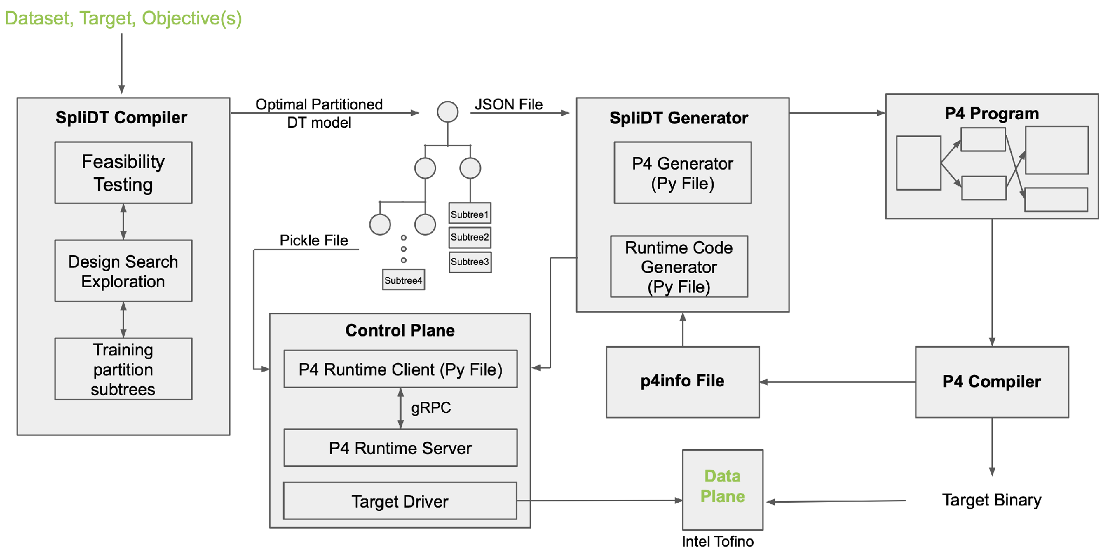
GSoC 2025 // SpliDT
What it actually looks like
train and partition the model > generate P4 > push tables over P4Runtime gRPC > run on Tofino
Notes:
Do not walk every box. Trace one path with your finger: dataset in on the left, target binary on the right, control plane underneath keeping the tables live.
The one thing to say out loud: the model is not running on a CPU next to the switch. It is compiled into the switch.
If asked what you personally built: the P4Runtime testing pipeline (Jinja2 templated, Tofino and Mininet) and the SID recirculation path.

Slide 12
LAYER 2 // THE KERNEL
eBPF: same move, one layer up
your rule
daemon
BPF bytecode
+ verifier
XDP / TC hook
user space
kernel, no module, no reboot
Run custom logic inside Linux without patching it or shipping a kernel module.
bpfilter translates firewall rules straight into BPF programs. GPLv2, designed originally by Alexei Starovoitov.
That repo lives under facebook/. It is where I contribute now, and the maintainers reply.
Notes:
Defensible: bpfilter is an eBPF-based packet filtering framework hosted at github.com/facebook/bpfilter, GPLv2. It translates filtering rules into BPF programs; it has a CLI (bfcli), a daemon, and a library, plus iptables and nftables front ends. It targets XDP, TC and BPF_NETFILTER program types. bpfilter was initially designed by Alexei Starovoitov.
Your merged PR is #507 (build: clang-tidy brace config, opts.c/set.c fixes, NOLINT in dump.c). Say 'build and lint hygiene' honestly if asked, do not inflate it.
This is the natural spot for the Bill Mulligan story if you want it. Keep it to two sentences.

Slide 13
LAYER 3 // THE RUNTIME
Stop handing out whole GPUs to small jobs
WITHOUT SHARING
WITH HAMi
1 job
idle
job 1
job 2
job 3
job 4
one physical GPU
same physical GPU, sliced by memory and compute
HAMi: a CNCF project that shares one GPU across many Kubernetes pods, no application changes.
WasmEdge: a CNCF sandbox WebAssembly runtime for cloud and edge, lighter than a container.
Notes:
Defensible: HAMi (Heterogeneous AI Computing Virtualization Middleware, formerly k8s-vGPU-scheduler) is a CNCF project, currently Incubating, listed in the CNCF and CNAI landscapes. It allocates a fraction of a device by memory, core or device count, enforces per-workload limits, and needs no application changes. It is a mutating webhook plus scheduler extender plus device plugins plus in-container virtualization.
WasmEdge is an official CNCF sandbox project, a lightweight high-performance WebAssembly runtime for cloud native, edge and decentralized applications.
The before/after picture is illustrative, not a benchmark. If someone asks for utilisation numbers, say it depends entirely on workload and you are showing the idea, not a measurement.
Your own HAMi work is scheduler and device-plugin bug fixes: PRs 2292, 2307, 2259, 2204, 2221.

Slide 14
THE PART NOBODY TELLS STUDENTS
Small field is a feature, not a warning
4 : 15
reachable
visible
P4 GSoC 2025 had four contributors and fifteen mentors. Read that ratio again.
Maintainers answer. You end up in a call with the people who wrote the thing.
Your patch is not lost in a queue of forty thousand. It has your name on it.
In India almost nobody is pointed at this. That is not a reason to stay away. That is the entire opportunity.
Notes:
The 4:15 number is from the official P4 GSoC 2025 wrap-up: four contributors (Xiyu, Vineet, Advay, Sankalp) and fifteen mentors, three org admins.
Say the India line plainly and then stop talking for a second. Do not soften it.
This is where a personal story belongs if you have thirty seconds spare.

Slide 15
WHAT I ACTUALLY WANT FROM YOU
Find the bottleneck. Go one layer down.
The thing everyone works around
is the thing worth reading the source of.
Most tools you use daily
were designed before the workload you actually run.
Do not build the five hundredth wrapper
when the layer underneath it is still an open problem.
That is the whole talk. Everything before this was evidence.
Notes:
Land it and stop. Do not add a fourth point.
If you want the Jira / agent-native rethink example, it goes here as one sentence, not as its own argument. Same move: something built for a world that no longer exists.

Slide 16

Thank you.
Questions, arguments, and better ideas all welcome.
sankalpjha.dev
Sankalp Jha // GSoC 2025, P4 Language Consortium
scan for everything else
Notes:
QR points to https://sankalpjha.dev/. Test it on your own phone before you walk on stage.

