Slide 1


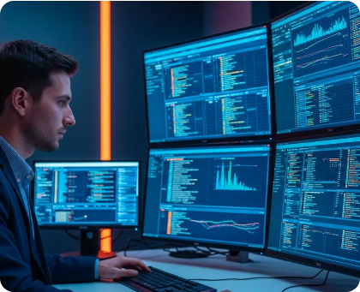

DFIR LIVE INCIDENT SIMULATION
CASE FILE #8042 • LIVE FORENSIC ANALYSIS
Investigating a Cyber Attack with Velociraptor
From initial suspicious activity to a complete, bulletproof attack timeline.
“At 09:17 this morning, something anomalous happened on a finance workstation.”
Tooling: Open-Source Velociraptor Platform
Objective: Root Cause, Scope & Timeline Reconstruction

Slide 2


Initial Telemetry Trigger SLIDE 02 / 21
09:17 AM — The Incident Alert
SOC automated monitoring detected high-risk activity on corporate host.
ALERT-ID: #8942-POWERSHELL
HOST:FIN-WS-042
You are the lead investigator.
USER:j.smith
ALERT:Suspicious PowerShell Execution
“What is the very first thing you want to know?”
PROCESS:powershell.exe
• What actually executed?
TIME:09:17:42 AM
• How did the attacker gain access?
NETWORK:Outbound Connection Detected
• Is the attacker still on the network?

Slide 3


Investigation Roadmap SLIDE 03 / 21
Our Investigation Objectives
Six critical forensic questions we must systematically answer.
01 • Initial Access
02 • Execution
03 • Persistence
How did the attacker get in?
What code did they run?
How did they maintain access?
04 • Discovery
05 • Activity
06 • Timeline
What did they look for?
What did they actually do?
Can we reconstruct the attack?
Goal: Our mission isn't just finding one suspicious file — it is reconstructing the entire attack story.

Slide 4








Core Methodology SLIDE 04 / 21
What is DFIR?
Digital Forensics & Incident Response: Evidence-driven response.
01
02
03
04
05
06
07
INCIDENT
PRESERVE
COLLECT
ANALYSE
CORRELATE
TIMELINE
RESPOND
Digital Forensics
Incident Response
What evidence exists on disk and memory?
What concrete actions do we take right now?

Slide 5


Scale Challenge SLIDE 05 / 21
Why Endpoint Forensics at Scale?
Comparing legacy manual triage against modern fleet-wide collection.
SCENARIO A • TRADITIONAL
SCENARIO B • VELOCIRAPTOR
1 Compromised Laptop
500+ Endpoints Simultaneously
→ RDP into host
→ Which machines ran PowerShell?
→ Manually inspect event logs
→ Where are the suspicious payloads?
→ Manually grab triage package
→ Where is persistence established?
→ Hours per machine
→ Query full fleet in < 5 minutes

Slide 6




Tool Spotlight SLIDE 06 / 21
Meet Velociraptor
Open-Source Digital Forensics & Incident Response Platform.
Endpoint Visibility
Artifact Collection
VQL Query Engine
Deep access to live memory and disk artifacts.
Automated triage packs and raw file extraction.
Expressive query language for custom hunting.
Threat Hunting
Remote Investigation
Timeline Generation
Targeted IOC hunts across thousands of hosts.
Zero physical access required for full collection.
Surgical chronological correlation of events.
“Think of Velociraptor as a forensic toolkit operating remotely across your endpoints.”

Slide 7


Investigation Architecture SLIDE 07 / 21
How We'll Investigate
Mapping forensic artifact types into a unified attack story.
PROCESSES
FILES & REGISTRY
EVENT LOGS
Parents, PIDs, CLI parameters
AppData drops & Run Keys
Security, Sysmon, ScriptBlock
“Every single artifact collected must answer a specific investigation question.”

Slide 8



Phase 1 • Identity Triage SLIDE 08 / 21
Phase 1: Who Was on the Machine?
Question: Who was logged in when the incident alert triggered?
VELOCIRAPTOR ARTIFACT FINDINGS
Forensic Deduction
HOST:FIN-WS-042
The machine was not sitting unattended. A legitimate user logged in interactively at 08:54 AM.
ACTIVE USER:j.smith
LOGON TIME:08:54:12 AM
SESSION TYPE:Interactive (Console)

Slide 9



Phase 2 • Execution Triage SLIDE 09 / 21
Phase 2: What Was Running?
Process Investigation: Examining active tasks and parentage.
ACTIVE PROCESS LIST
SUSPICIOUS PROCESS DETAILS
explorer.exe
PROCESS: powershell.exe
chrome.exe
PID: 4812
outlook.exe
PARENT PROCESS: WINWORD.EXE (PID 3104)
WINWORD.EXE
EXECUTION TIME: 09:17:39 AM
Teams.exe

Slide 10




Process Lineage Analysis SLIDE 10 / 21
Follow the Process Tree
Deobfuscating execution parameters and command-line arguments.
WINWORD.EXE (PID 3104)
│
└──► powershell.exe (PID 4812)
│
└──► cmd.exe (PID 5092)

Slide 11
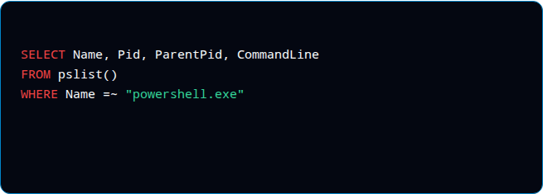

Query Engine Syntax SLIDE 11 / 21
Enter VQL (Velociraptor Query Language)
Instead of manual clicks, we ask the endpoint targeted queries.
// VQL Execution Triage Query
SELECT
What specific data fields do I want?
FROM
Which plugin/artifact provides the data?
WHERE
What specific condition filters the search?

Slide 12


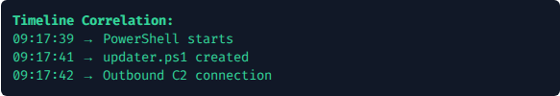
Phase 3 • File System Artifacts SLIDE 12 / 21
Phase 3: What Did PowerShell Drop?
Question: What files were created around 09:17 AM?
DISCOVERED FILE ARTIFACT
PATH: C:\Users\j.smith\AppData\Roaming\updater.ps1
CREATED: 09:17:41 AM
MODIFIED: 09:17:42 AM
USER OWNER: j.smith
High-Risk Drop Locations
• AppData\Roaming\
• AppData\Local\Temp\
• Downloads\
• ProgramData\

Slide 13

Phase 4 • Persistence Analysis SLIDE 13 / 21
Phase 4: How Does the Attacker Come Back?
Question: If the workstation reboots, how is access re-established?
REGISTRY PERSISTENCE DETECTED
KEY: HKCU\Software\Microsoft\Windows\CurrentVersion\Run
VALUE NAME: Updater
COMMAND: powershell.exe -File C:\Users\j.smith\AppData\Roaming\updater.ps1

Slide 14

Multi-Source Corroboration SLIDE 14 / 21
Corroborating via Windows Event Logs
Never rely on a single artifact. Multiple sources prove the story.
Event ID | Source | Forensic Telemetry Provided
4624 | Security | Interactive logon activity for j.smith at 08:54 AM
4688 | Security | WINWORD.EXE spawning powershell.exe process
4104 | PowerShell | Deobfuscated ScriptBlock content of updater.ps1
Sysmon 1 / 3 | Sysmon | File hashes (SHA256) and outbound network IP:Port

Slide 15
Attack Reconstruction SLIDE 15 / 21
The Master Attack Timeline
Sequencing evidence chronologically to reveal the exact attack sequence.
08:54 AM
User j.smith logs into FIN-WS-042 interactively
09:16 AM
User opens malicious attachment Invoice_Q3.doc in Word
09:17 AM
WINWORD.EXE executes encoded PowerShell command
09:17 AM
Payload dropped to disk: updater.ps1
09:18 AM
Registry Run Key persistence written
09:21 AM
Outbound C2 beacon established

Slide 16




MITRE ATT&CK Mapping SLIDE 16 / 21
Reconstructing the Attack Chain
Mapping our forensic findings into industry standard tactics.
INITIAL ACCESS
EXECUTION
PERSISTENCE
COMMAND & CONTROL
Spearphishing
PowerShell
Registry Run Key
Outbound Beacon
Malicious Word doc attachment
Macro launches encoded CLI
HKCU Auto-start key created
Encrypted traffic channel
“We can now present this incident in a language executive leadership and security ops understand.”

Slide 17

Scope Verification SLIDE 17 / 21
Case Closed?
Not yet.
“What if FIN-WS-042 wasn't the only compromised machine?”
Immediate Triage Actions:
Enterprise Hunt Actions:
•
• Isolate FIN-WS-042 network connection
•
• Search all 500 endpoints for updater.ps1
•
• Block C2 IP addresses at firewall
•
• Hunt for matching Registry Run keys
•
• Reset credentials for j.smith
•
• Scan memory for active C2 beacons

Slide 18

Enterprise Hunt Results SLIDE 18 / 21
The Twist: Enterprise Hunt Reveal
VQL Hunt Target: Discovered IOC artifact (updater.ps1)
FIN-WS-042 🚨
FIN-WS-043 🚨
ENG-WS-019 🚨
HR-WS-007 🚨
Finance • Patient Zero
Finance • Lateral Movement
Engineering • Payload Present
Human Res. • Active Beacon
We thought we had 1 compromised endpoint. We actually have 4.
This is where endpoint threat hunting transforms into incident response at scale.

Slide 19



Remediation Execution SLIDE 19 / 21
From Investigation to Response
Executing immediate containment, eradication, and post-incident learning.
01 • CONTAIN
02 • ERADICATE
03 • HUNT & RECOVER
• Isolate 4 affected endpoints
• Remove Registry Run keys via VQL
• Sweep full enterprise for TTPs
• Block C2 domain/IP at gateway
• Delete updater.ps1 from AppData
• Restore clean workstation state
• Revoke active domain tokens
• Kill malicious PowerShell PIDs
• Update SOC detection rules

Slide 20




Session Summary SLIDE 20 / 21
Core Session Takeaways
Seven key principles for modern digital forensics and incident response.
🔎 Evidence-Based DFIR
🦖 Rapid Velociraptor
💻 Power of VQL
Investigate based on facts, never assumptions.
Collect forensic data across endpoints in seconds.
Turn investigation questions directly into queries.
🔐 Persistence Identification
📜 Windows Telemetry
🕐 Attack Timelines
Attackers always create mechanisms to survive reboots.
Corroborate findings across independent log sources.
Sequence discrete events into a coherent story.

Slide 21


“THE ATTACKER DOESN'T HAVE TO TELL YOU WHAT THEY DID.
THE EVIDENCE WILL.”
Investigating a Cyber Attack with Velociraptor: A Story-Driven DFIR Investigation
github.com/Velocidex/velociraptor
Velociraptor DFIR Documentation & Labs
“The question isn't whether an attacker left evidence. The question is whether you know where to look.”

