Slide 1
ModSecurity가 가고 Coraza가 온다
The ModSecurity is slowly coming to an end and the Coraza era is coming.
Jeff gy Kim(김관영), hocheol Shin(신호철)

Slide 2
발표자 소개
OpenStack loves Ubutu
esp. more in Korea
Jeff gy Kim OpenInfra(OpenStack) Korea community organizer
GroMetric Corp Founder & CTO
CKA/CKAD, AWS Pro/Asso, GCP PCA, CCIE, MBA
Hocheol Shin
OpenInfra(OpenStack) community organizer
Chef community organizer
CAFE24 Team Leader, OSS Contributor

Slide 3
Intro
WAF가 뭔가유?
OWASP???
ModSecurity???
Yu-na Kim(World famous figure skater)
https://en.wikipedia.org/wiki/Web_application_firewall

Slide 4
Intro
WAF는 뭔가요?
Web Application Firewall
OWASP
Open Worldwide Application Security Project 매년 웹 취약점을 분석하여 OWASP top10 리스트를 발표
ModSecurity???
open-source web application firewall from 2002
Coraza
open-source web application firewall
NGINX App Protect
nginx 기반의 web application firewall
From Min-sik Choi movie Rules of the Time
https://en.wikipedia.org/wiki/Web_application_firewall

Slide 5
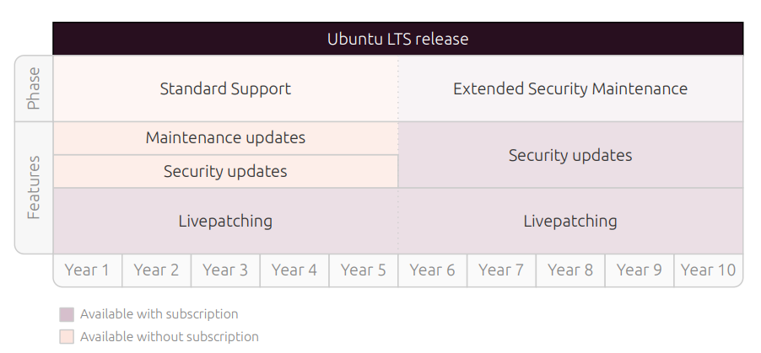
Ubuntu의 기본적인 cybersecurity & Vulnerability 대응
1. Predictable lifecycle
Ubuntu Pro subscription 계정당 5 machines까지 무료
Ubuntu Pro which is free of charge for personal use on up to 5 machines
Kernel Livepatching:
No Service interruption, no reboot, can be apply On-prem(Bloomberg, AT&T, DeutscheTel, NTT, etc)
Data Source: cybersecurity with Ubuntu https://ubuntu.com/engage/ubuntu-cybersecurity-webinar https://ubuntu.com/pro

Slide 6
Ubuntu의 기본적인 cybersecurity & Vulnerability 대응
2. Certified Compliance
FIPS 140 및 CC, EAL2 인증뿐만 CIS 및 DISA-STIG와 같은 취약점 관리, 강화 및 컴플라이언스 프로파일을 통해 사이버 보안 프레임워크 마련
3. Secure configuration & hardening
Canonical에서는 Ubuntu의 구성을 강화하기 위해 CIS 벤치마크 적용 권고
usg audit/fix command
sudo apt update
sudo apt install ubuntu-advantage-tools
sudo ua enable usg
sudo apt install usg
/usr/share/ubuntu-scap-security-guides/cis-hardening/Canonical_Ubuntu_20.04_CIS-harden.sh
usg fix
/usr/share/ubuntu-scap-security-guides/cis-hardening/Canonical_Ubuntu_18.04_CIS-harden.sh
usg fix
/usr/share/ubuntu-scap-security-guides/cis-hardening/Canonical_Ubuntu_16.04_CIS_v1.1.0-harden.sh
usg fix
cis-audit
usg audit
FIPS: Federal Information Processing Standards
CC: Common Criteria
EAL2: Evaluation Assurance Level CIS: Center for Internet Security
DISA-STIG: Defense Information Systems AgencySecurity Technical Implementation Guides
cybersecurity with Ubuntu https://ubuntu.com/pro

Slide 7
Ubuntu의 기본적인 cybersecurity & Vulnerability 대응
4. Vulnerability Management
software security updates (including kernel livepatching), security advisories, and machine readable OVAL* vulnerability data for SIEM integration and automation for the lifecycle of all relevant systems.
SLA(targets a response time) :
Critical - 1 day, High 14 days average
5. Anti-exploitation defenses
Heap and stack protections, ASLR, and non-executable memory
* OVAL: Open Vulnerability and Assessment Language * ASLR: Address Space Layout Randomization, 공격자가 익스플로잇 코드를 작성할 때 페이로드가 어느 위치에 삽입되야 하는지를 미리 예측할 수 없도록 함

Slide 8
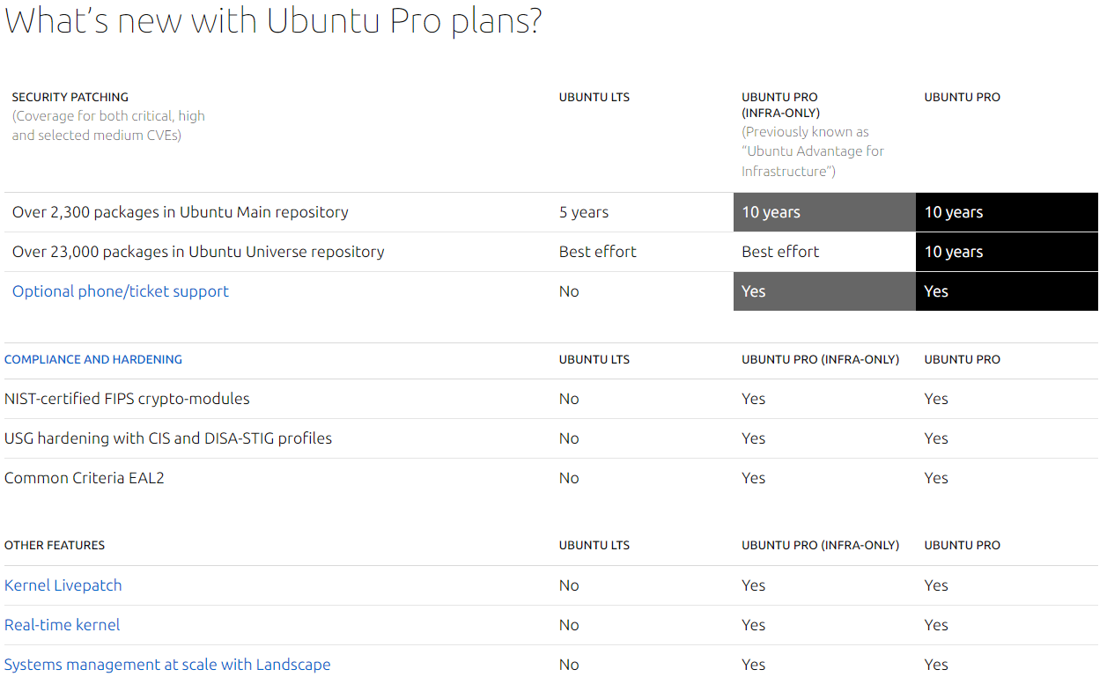
Ubuntu Pro

Slide 9
OWASP top 10
WAF는 뭔가요?
Web Application Firewall의 약자 웹서버와 주고받는 Http/Https 트래픽을 필터링, 모니터링 및 차단하는 특정 형태의 애플리케이션 방화벽
OWASP Top 10
2003년 부터 발표되었으며 매년 정기적으로 업데이트되며 가장 중요한 위험 중 일부를 식별하여 애플리케이션 보안에 대한 인식을 높이는 것을 목표로 발표 됩니다. MITRE, PCI DSS , DISA-STIG ) 및 U.S. 정부에서 상위 10개 프로젝트를 참조
https://en.wikipedia.org/wiki/Web_application_firewall

Slide 10
ModSecurity EoL: It will be OK, but Can't say how long
1. First Open-Source WAF
ModSecurity WAF engine is set to go EOL on 1 July 2024.
2. 2021년 ModSecurity의 개발사인 Trustwave는 블로그를 통해 2024년 ModSecurity 지원 종료를 발표했습니다 . 블로그에도 Trustwave가 "오픈 소스 커뮤니티가 프로젝트를 계속하도록 할 것”이라고 발표
하지만, OWASP는 Trustwave의 기존 약속을 존중하면서 프로젝트 관리를 맡길 수 있는 스폰서를 유치하겠다고 제안했으나, 협의가 이루어지지 않음, Trustwave는 그들의 약속이 지켜지지 않음(ModSecurity는 Apache 2.0 라이선스)
Data Source: Dr. Christian Folini writing in CRS org Andrew Howe writing in Loadbalancer

Slide 11
ModSecurity EoL: It will be OK, but Can't say how long
실제 2018년부터 maintenance 정도만 이루어짐,
ModSecurity V2(Apache, IIS), V3(NGINX) 다른 버전을 쓸 수 밖에 없음
2. At its core, a WAF is made up of two component parts:
- A WAF engine: ModSecurity => Coraza
- WAF rules: CoreRuleSet org라는 OSS Ruleset을 개발 적용
3. OWASP/CRS org
- name: OWASP Coraza
- Coraza Logo : Sancho(named by OWASP)
Data Source: Dr. Christian Folini writing in CRS org Andrew Howe writing in Loadbalancer

Slide 12
OWASP Coraza
Coraza : Spanish, breastplate(중세 기사의 가슴보호 갑옷)
1. Coraza is an implementation of a SecLang engine in the memory-safe
Go language, developed by Juan Pablo Tosso from Chile
2. Simple view
- A WAF engine: ModSecurity => OWASP Coraza
- WAF rules: CoreRuleSet org의 oss Ruleset을 개발 적용 가능(tested all items)
3. Support: Caddy reverse proxy(Web Server engine), WASM extension
Data Source: Juan Pablo Tosso(Author of Coraza)

Slide 13
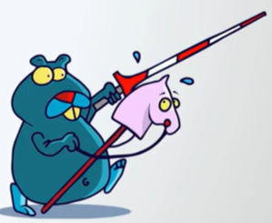
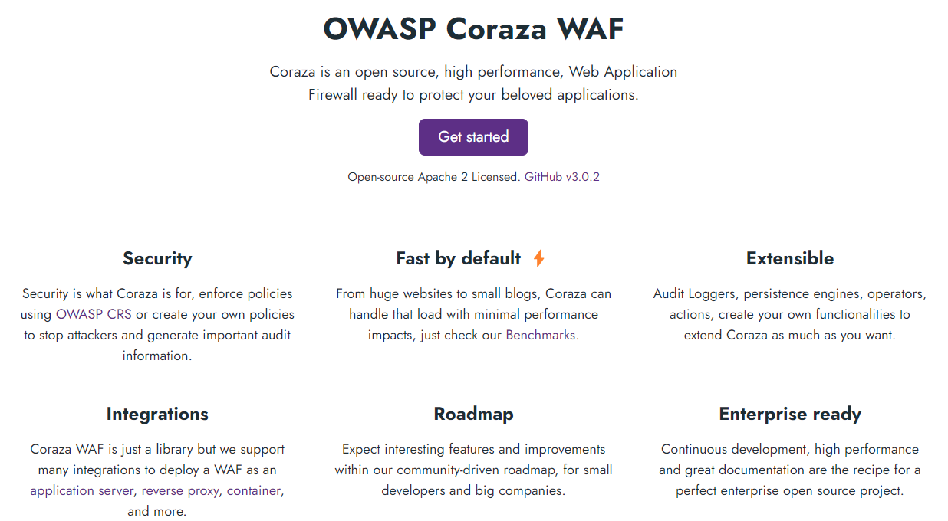
OWASP Coraza
Functions
Tracing
gRPC
SPOE
WASM
GraphQL
Horizontal Scaling
SPOE: Streaming Processing Offload Engine

Slide 14
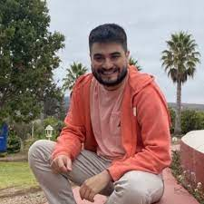
OWASP Coraza
4. Juan Pablo Tosso short interview
Q) Do you have rough roadmaps for Apache and NGINX?
We do have a firm plan using libcoraza for nginx, but we don't have the resources right now to maintain it, as we are limited to WASM and caddy. I don't think we will support Apache unless there is a proxy wasm connector or something we can use.
Q) What is your plan for Coraza expansion with OWASP? It makes total sense to become a flagship project. A WAF is a core product in every company's cybersecurity roadmap; we expect OWASP to manifest that.
Juan Pablo Tosso(Author of Coraza)

Slide 15
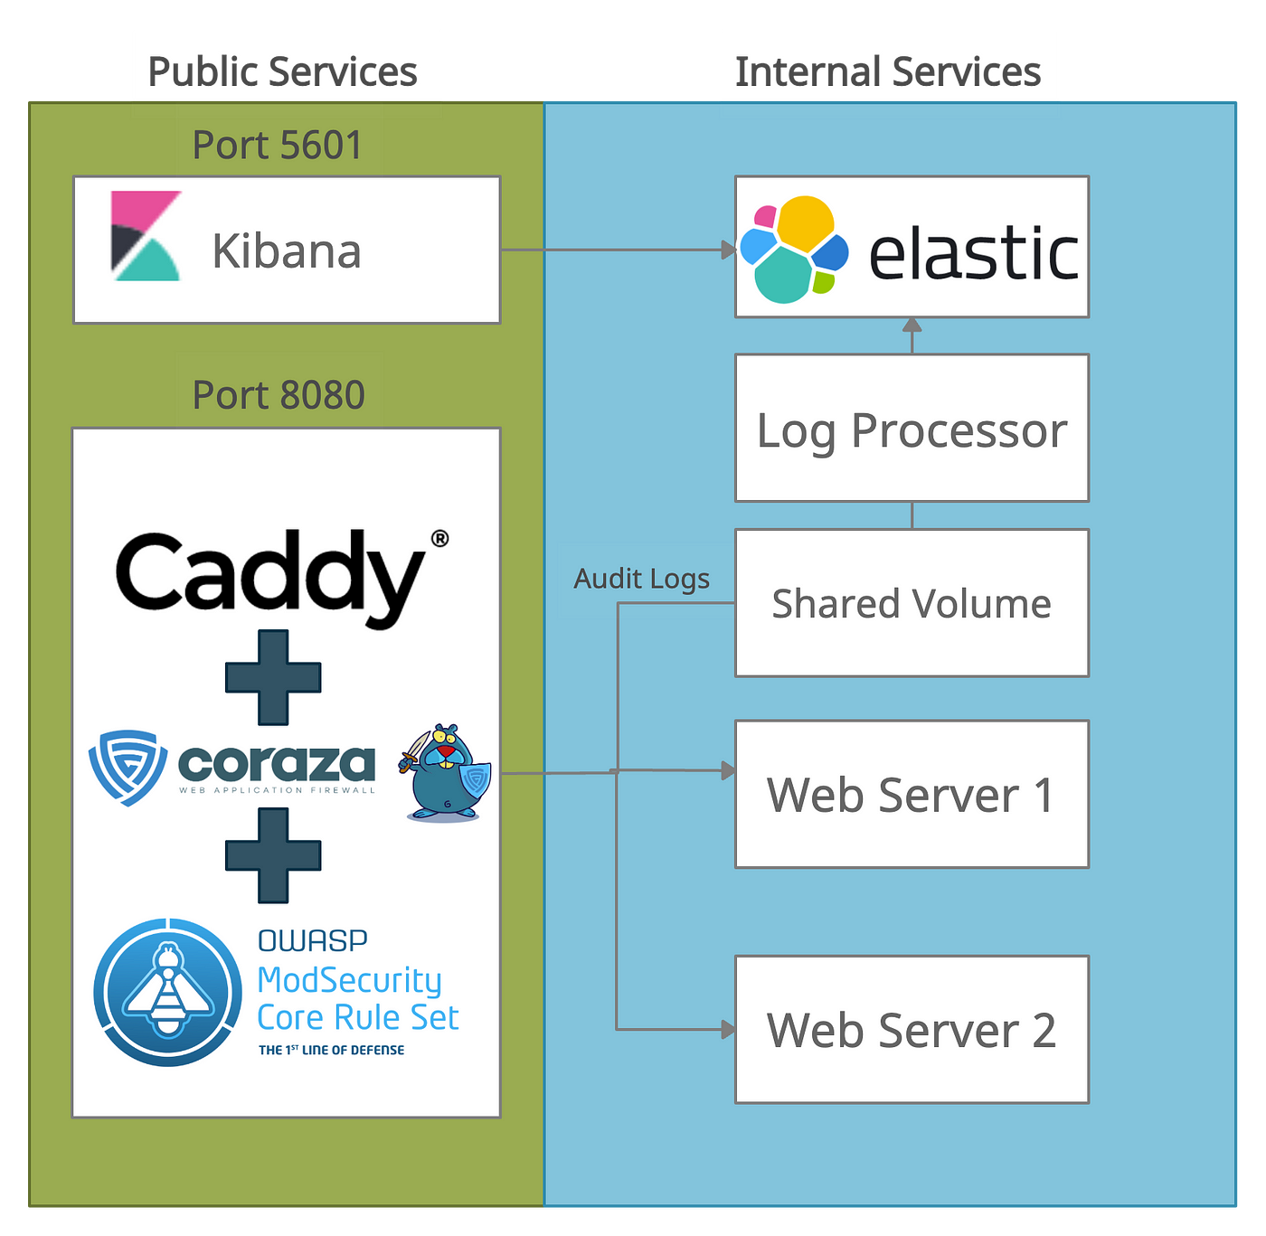
OWASP Coraza demo
1. Environment: Coraza+CRS+Caddy, elastic+Kibana
2. Ubuntu 22.04 LTS
- Docker compose
- Go 1.9
3. Support
- Caddy reverse proxy(Web Server engine)
https://medium.com/@jptosso/oss-waf-stack-using-coraza-caddy-and-elastic-3a715dcbf2f2
Data Source: Juan Pablo Tosso(Author of Coraza)

Slide 16
Coraza demo
Coraza demo 영상
https://www.youtube.com/watch?v=0zduraUew54
Data Source: Juan Pablo Tosso(Author of Coraza)

Slide 17
Comparison: ModSec Coraza NAP
 | ModSecurity | Coraza | NAP(NGINX App Protect)
Support | Apache, IIS, NGINX | Caddy Plugin WASM extension | Container, Kubernetes CI/CD Integration(with NGINX Plus) roadmap NGINX OSS
Deploy | Embedded on Linux Container | Embedded on Linux Container | Embedded on Linux Side-car Container KIC(Kubernetes Ingress Controller)
Bot Detect & Prevention | CoreRuleSet (Fake Bot Plugin) | CoreRuleSet (Fake Bot Plugin) | Automated tool(Classified bot class)
Signature | CoreRuleSet | CoreRuleSet | Threat Intelligence 통합 Same as F5 WAF
DDoS(L7 HTTP/API call) | CoreRuleSet | CoreRuleSet | Same as F5 AWAF(Advanced)
SLA(commercial support) | by Trustwave | Will be by someone | by F5
https://www.nginx.com/blog/announcing-open-source-subscription-f5-nginx /https://coraza.io/docs/tutorials/introduction/
Notes:
Arcadia NAP playbook

Slide 18
NGINX OpenSource 버전 Subscription
1. Enterprise Level Support
- SLA options of business hours or 24/7
- Security patches and bug fixes, Security notifications, Debugging and error correction
2. Enterprise Features: NGINX Plus feature 사용 가능
- API rate limiting, session persistence, high availability, and active health checks, real-time monitoring, native OpenTelemetry
- Improve Security and Identity Management
3. Fleet Management: NGINX Management Suite Instance Manager
Data Source: Dr. Christian Folini writing in CRS org Andrew Howe writing in Loadbalancer

Slide 19
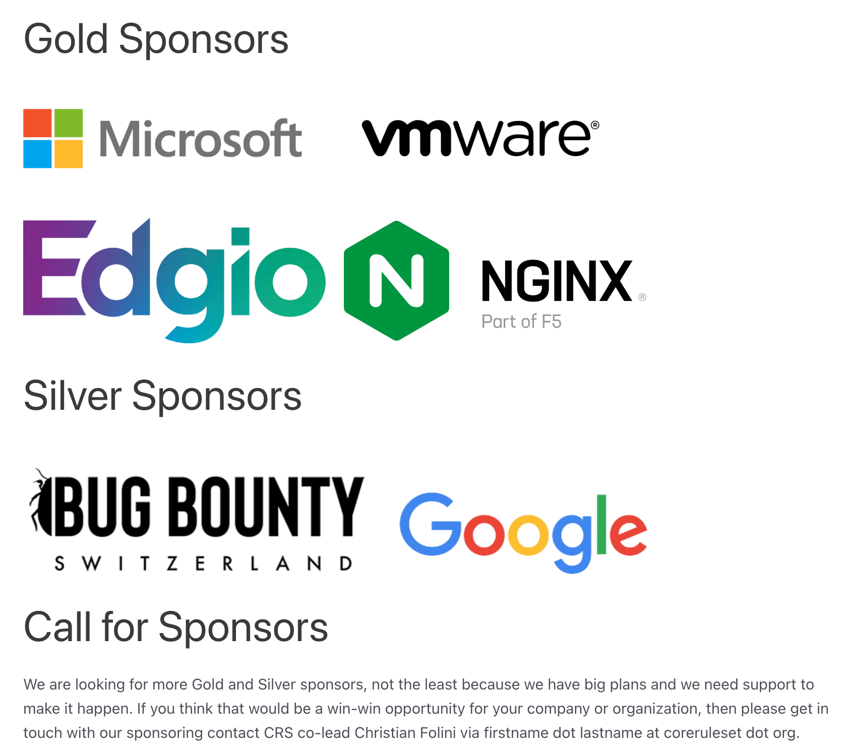
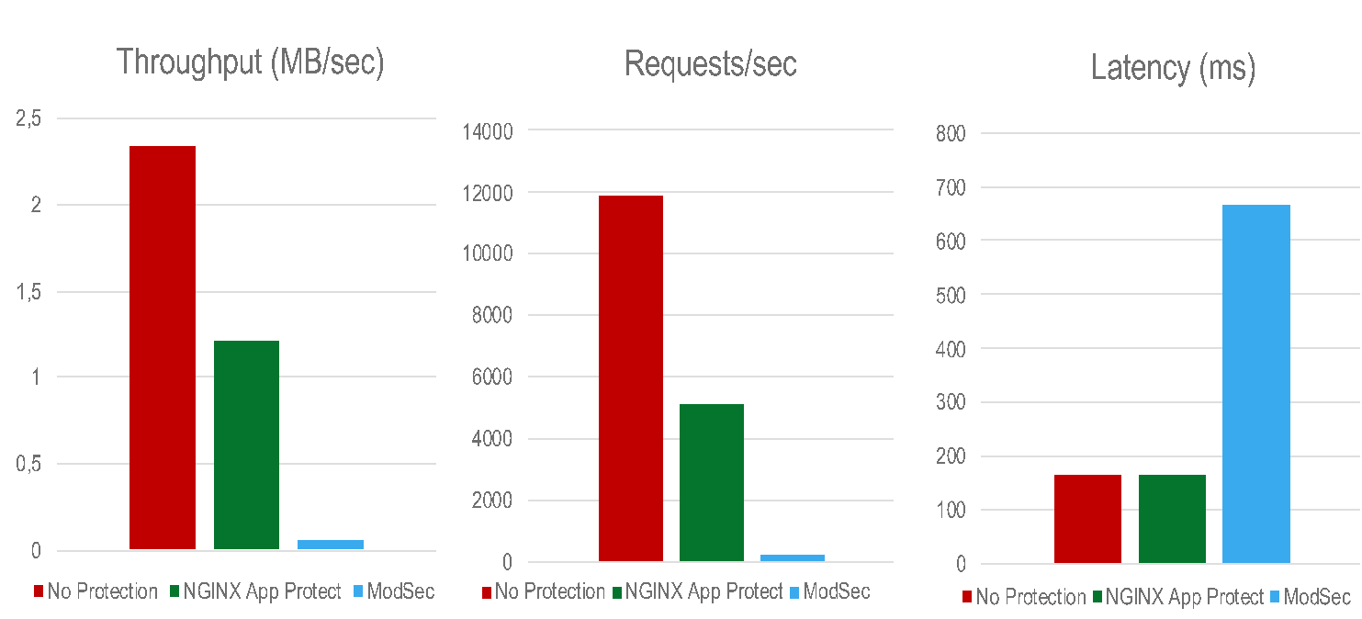
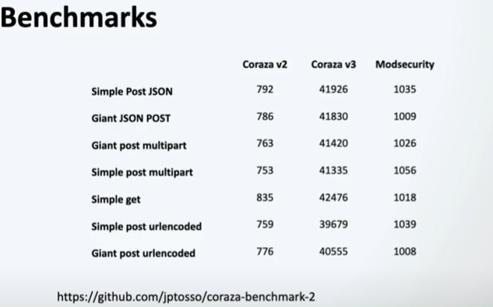
Comparison: ModSec Coraza NGINX App Protect
CoreRuleSet.org
NGINX App Protect/ModSecurity Performance
Coraza v3 was designed with enterprise-grade performance.
Data Source: www.nginx.com, Coreruleset.org

Slide 20
QnA
Special thanks to
CAFE24 Cloud
OpenStack
All Tested items were run on the

Slide 21
We’re Hiring
Gro^{wth}Metric
SojuOps, Working From Home(3 days a week)

