Slide 1
회사보안 아래에서 우분투 WSL 사용하기
이병규 Lee ByungKyu

Slide 2
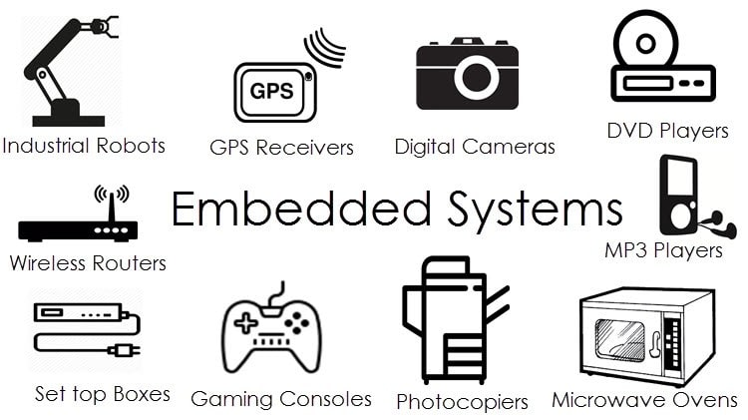
자기소개
Electronic engineering
42 Seoul
Embedded engineer

Slide 3
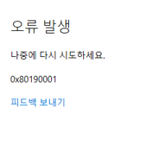
Microsoft store doesn’t work

Slide 4
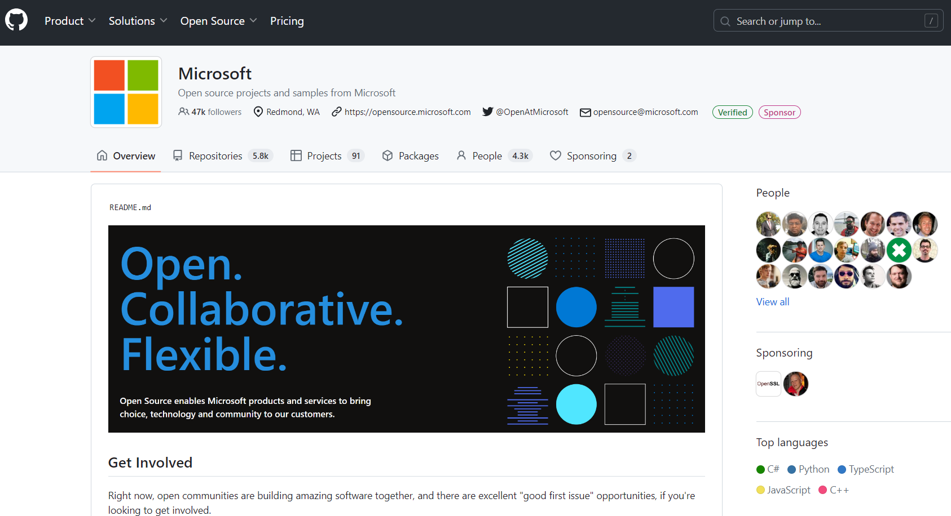
Installing windows terminal
https://github.com/microsoft

Slide 5
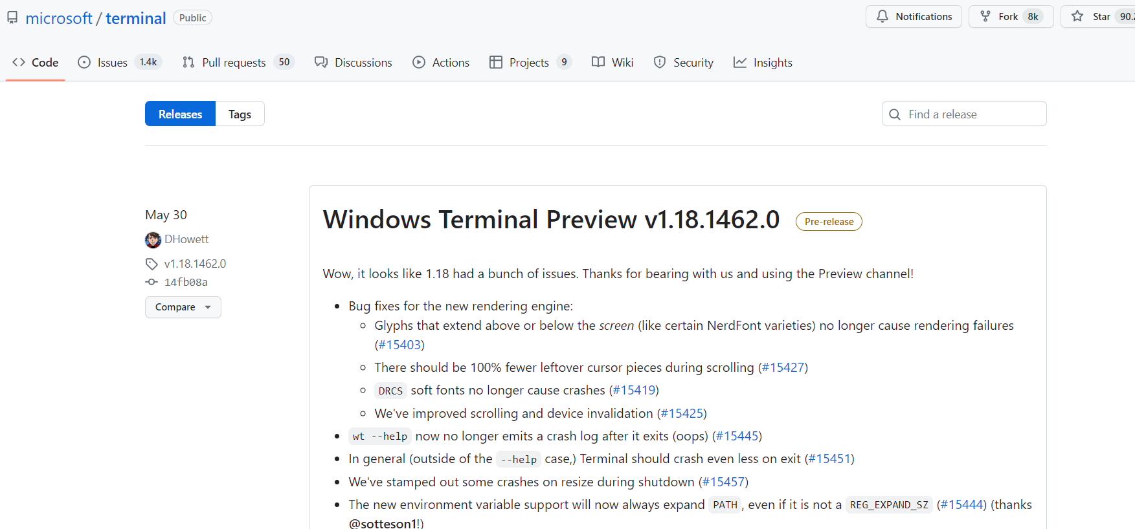
Installing windows terminal

Slide 6
Installing windows terminal

Slide 7
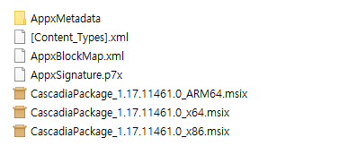
Installing windows terminal

Slide 8
Installing windows terminal

Slide 9
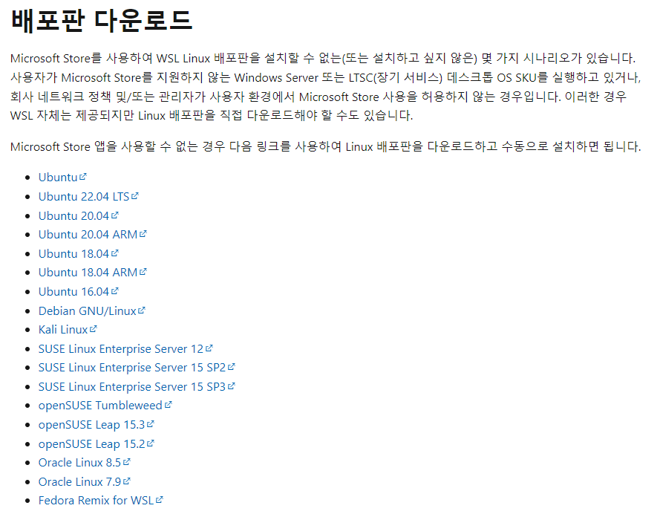
Installing Ubuntu
https://learn.microsoft.com/ko-kr/windows/wsl/install-manual

Slide 10
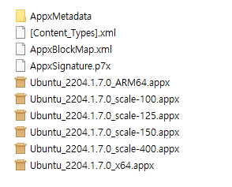
Installing Ubuntu

Slide 11
Package Manager doesn’t work
apt, wget, …

Slide 12
Yocto
Build system for embedded
Have to install all packages to use But, package manager doesnt work..

Slide 13
Yocto
To solve problems…
1. Disable ssl
2. Add dns server
3. Change apt-get package download server (sources.list)
(4. take laptop out of company)

Slide 14
Cuda
Security team manages windows version
There are a few Windows version that are not compatible with cuda in wsl…

Slide 15
Copilot doesn’t work
GitHub Copilot could not connect to server. Extension activation failed “self signed certificate in certificate chain”
Man in the middle appliance dynamically breaks open all secure SSL traffic leaving so that can monitor all traffics
This leaves behind a fake cert chain as a fingerprint. The cert replaced with a fake one.
‘win-ca’ extension solves this issue by telling Vscode to trust CA.

Slide 16
So why? - Minimum blocking

Slide 17
Thank you

